Slide 1
2022 Midterm Election Outlook

Slide 2
Congress is on the Line
Majority in Both Chambers at Stake
Senate: Republicans need net gain of 1 seat for majority
House: Republicans need net gain of 5 seats for majority

Slide 3
Three Midterm Scenarios
1a) GOP House / Dem Senate
1b) Republicans Sweep Congress
3) Democratic Expansion

Slide 4
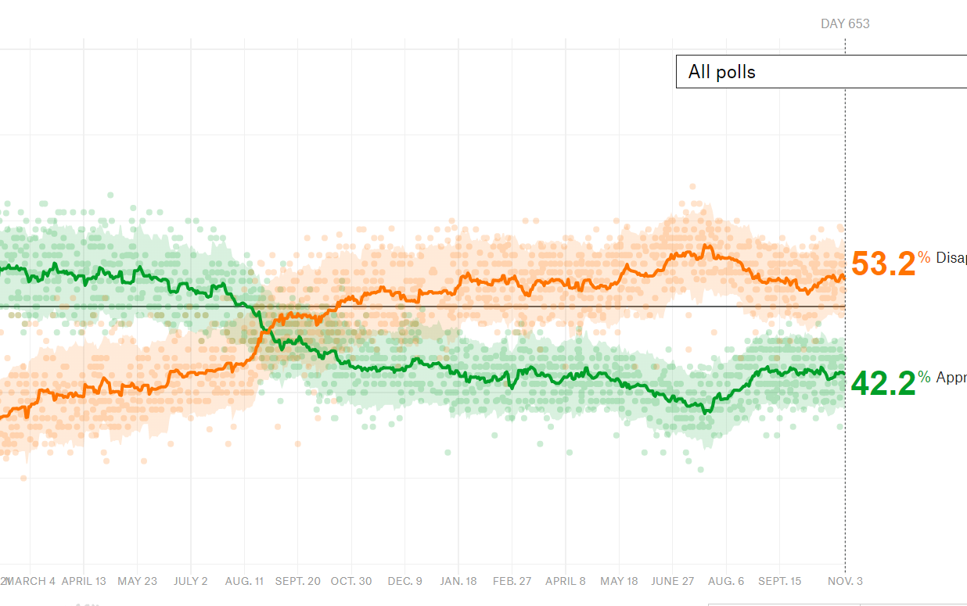
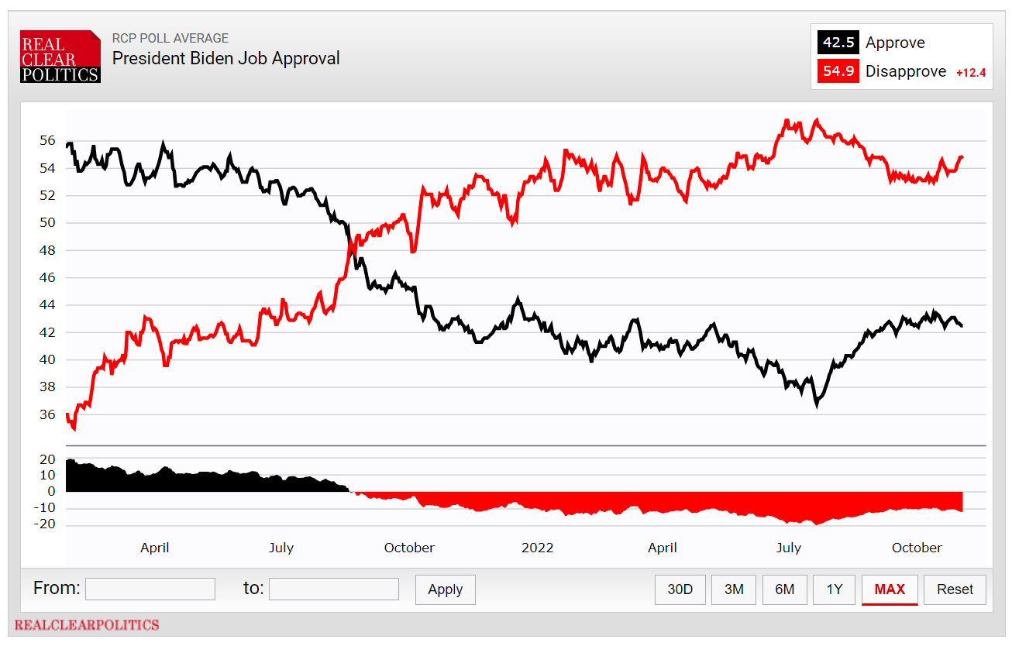
Presidential Approval

Slide 5
Fight for the Senate

Slide 6
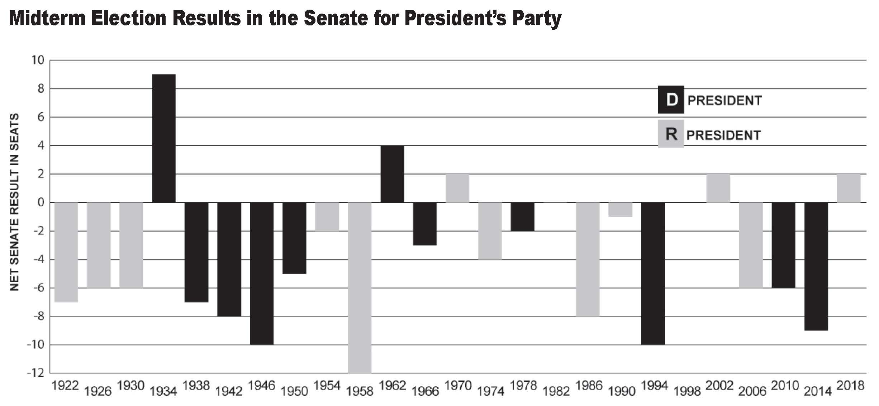
Midterm Trend: Senate Races

Slide 7
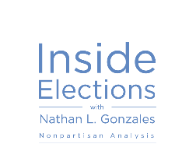
2022 Senate Races
Democratic Seats: 14
Republican Seats: 21
SOLID D
LIKELY D
LEAN D
TILT D
TOSS UP
TILT R
LEAN R
LIKELY R
SOLID R
LEAN D
FL – Rubio
IA – Grassley
UT – Lee
MO – Open (Blunt)
AR – Boozman
ID – Crapo
ND – Hoeven
LA – Kennedy
OK – Lankford
OK – Open (Inhofe)
KS – Moran
AK – Murkowski
KY – Paul
SC – Scott
AL – Open (Shelby)
SD – Thune
IN – Young
CO – Bennet
WA – Murray
NH – Hassan
AZ – Kelly
NV – Cortez Masto
GA – Warnock
PA – Open (Toomey)
NC – Open (Burr)
WI – Johnson
OH – Open
(Portman)
CT – Blumenthal
IL – Duckworth
VT – Open (Leahy)
CA – Padilla
HI – Schatz
NY – Schumer
MD – Van Hollen
OR – Wyden

Slide 8
The Big Picture
12 races currently rated Solid, Likely, Lean, or Tilting Democratic (36 seats not up for election)
20 races currently rated Solid, Likely, Lean, or Tilting Republican (29 seats not up for election)
3 pure Toss-ups
Current projection: GOP +2 to Dem +1
Democrats have control of a 50-50 Senate with Vice President Kamala Harris as the tie-breaking vote.

Slide 9
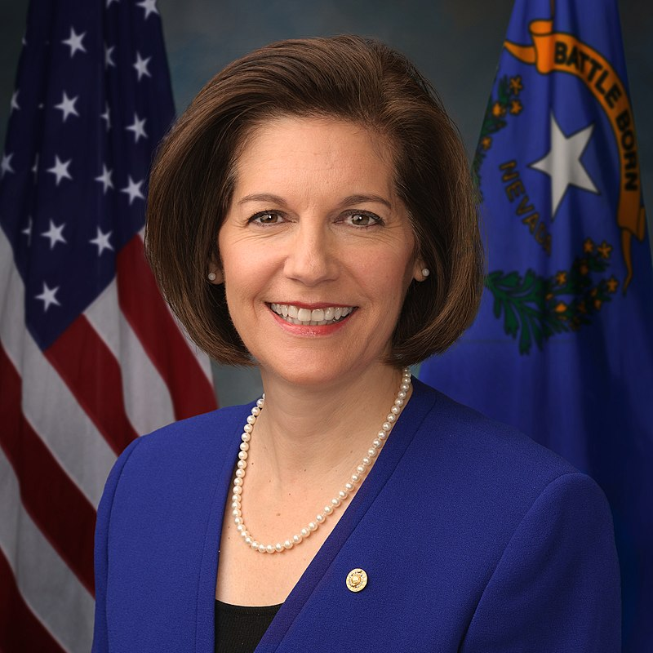
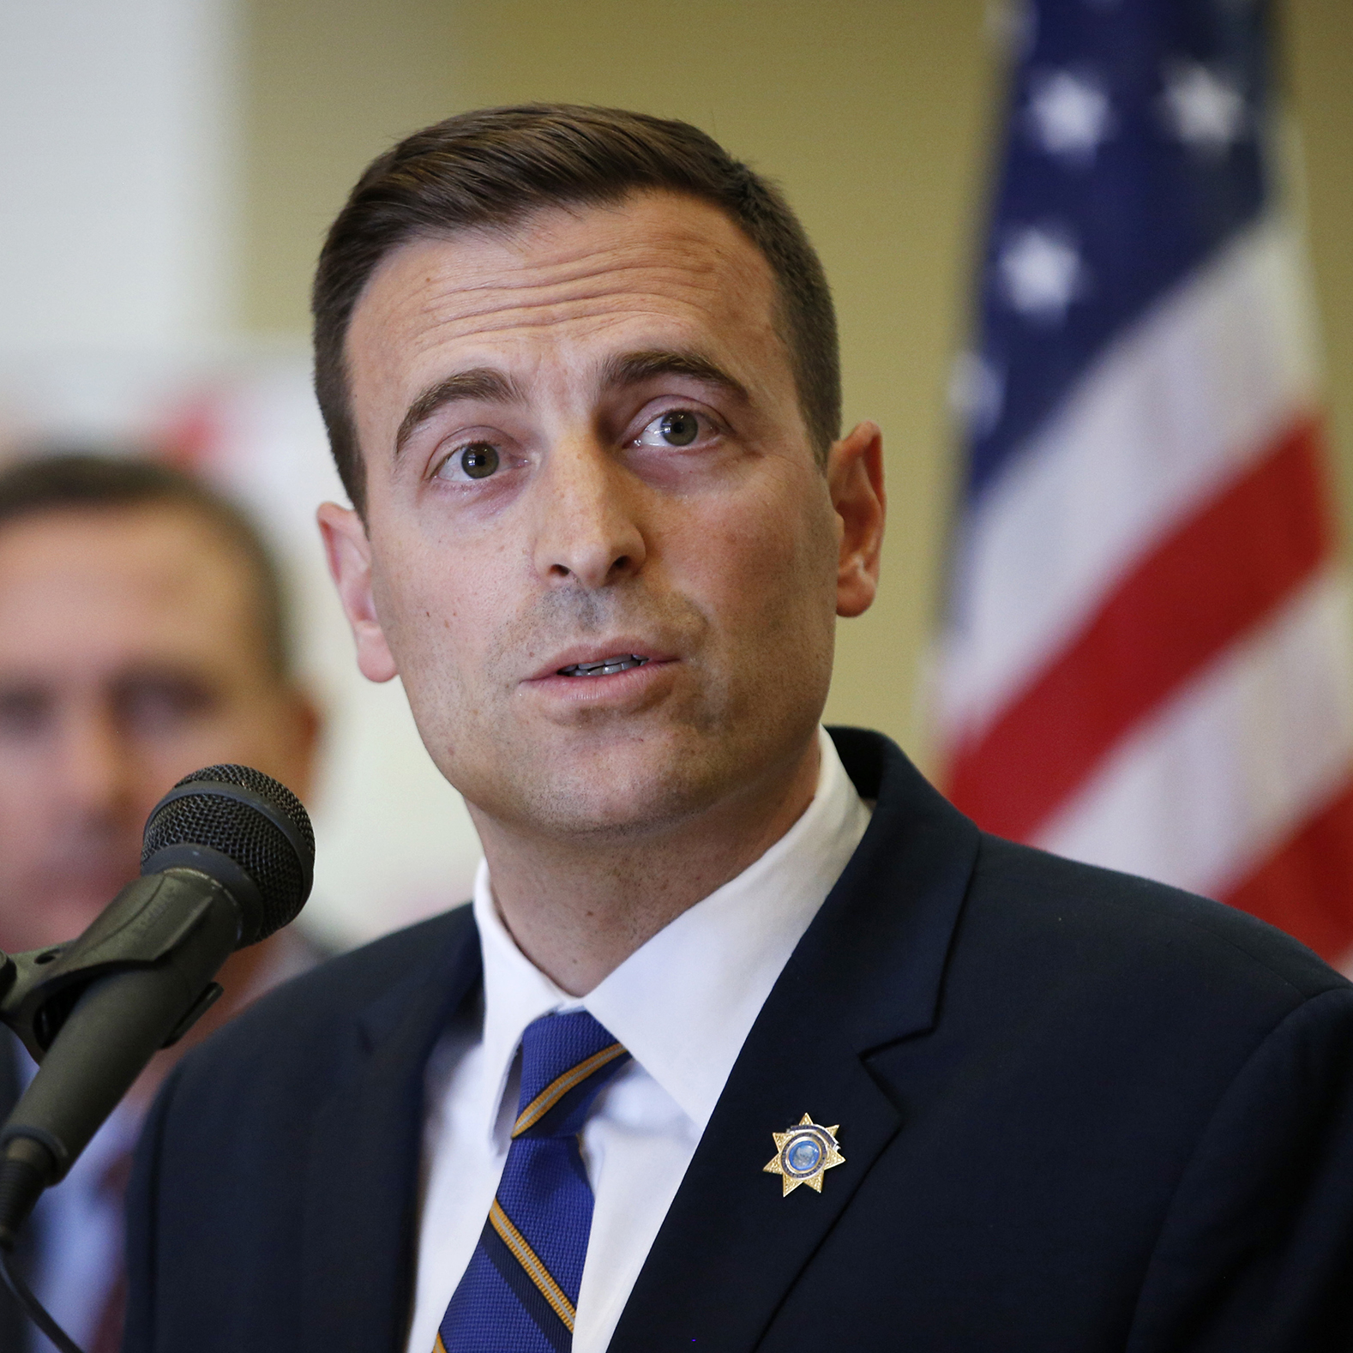
Nevada
Sen. Catherine Cortez Masto (D)
Rating: Toss-up
Incumbent Catherine Cortez Masto (D)
Beat Rep. Joe Heck 47-45% in 2016 election
Republican Nominee
Former State Attorney General Adam Laxalt
Won GOP primary with 56%
Baseline performance:
Republican 49%
Democratic 46%
*Baseline is a metric developed by Inside Elections that calculates generic party
performance over the last four election cycles (2014-2020)

Slide 10
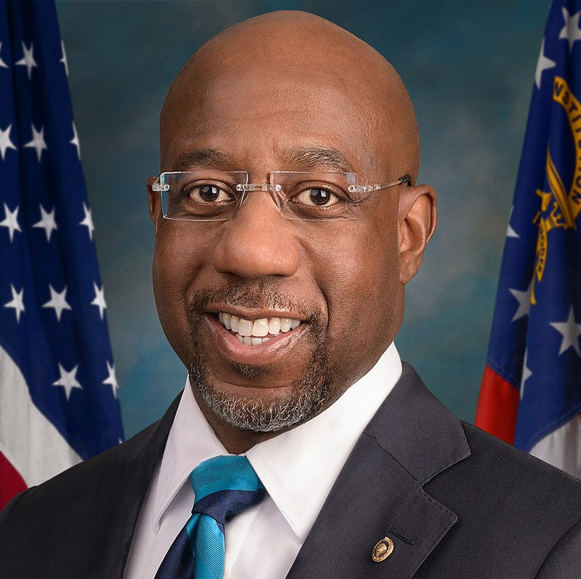
Georgia
Sen. Raphael Warnock (D)
Rating: Toss-up
Incumbent Raphael Warnock (D)
Beat Sen. Kelly Loeffler 51-49% in 2021 special election runoff
Republican Nominee
Former NFL player Herschel Walker
Won GOP primary with 68% of the vote
Baseline performance:
Republican 53%
Democratic 46%
Potential for December 6, 2022 runoff
*Baseline is a metric developed by Inside Elections that calculates generic party
performance over the last four election cycles (2014-2020)

Slide 11
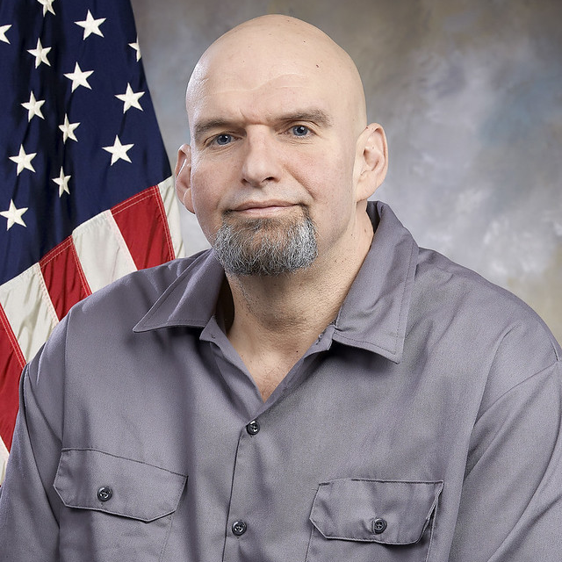
Pennsylvania
Sen. Pat Toomey (R)
Rating: Toss-up
Incumbent Pat Toomey (R) not seeking re-election
Republican Nominee
Celebrity surgeon Dr. Mehmet Oz
Won primary with 31%
Democratic Nominee
Lt. Gov. John Fetterman
Won primary with 59%
Baseline performance:
Democratic 51%
Republican 47%
*Baseline is a metric developed by Inside Elections that calculates generic party
performance over the last four election cycles (2014-2020)

Slide 12
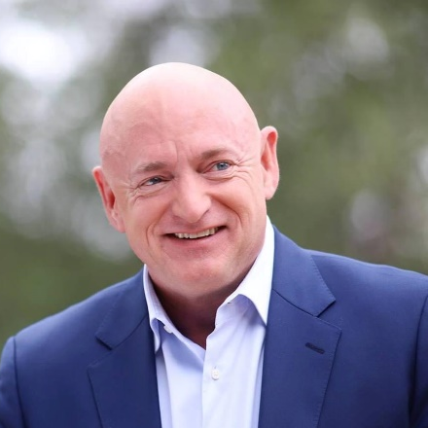
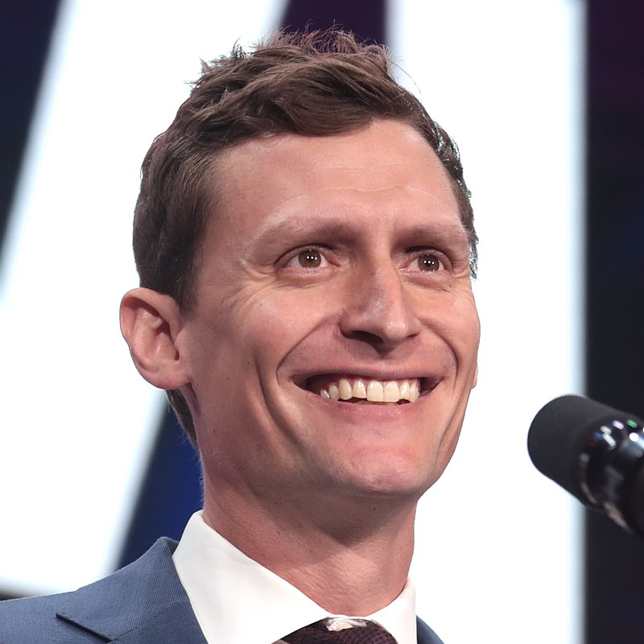
Arizona
Sen. Mark Kelly (D)
Rating: Tilt Democratic
Incumbent Mark Kelly (D)
Beat Sen. Martha McSally 51-49% in 2020 special election
Republican Nominee
Venture capitalist Blake Masters
Won GOP primary with 40%
Baseline performance:
Republican 51%
Democratic 48%
*Baseline is a metric developed by Inside Elections that calculates generic party
performance over the last four election cycles (2014-2020)

Slide 13
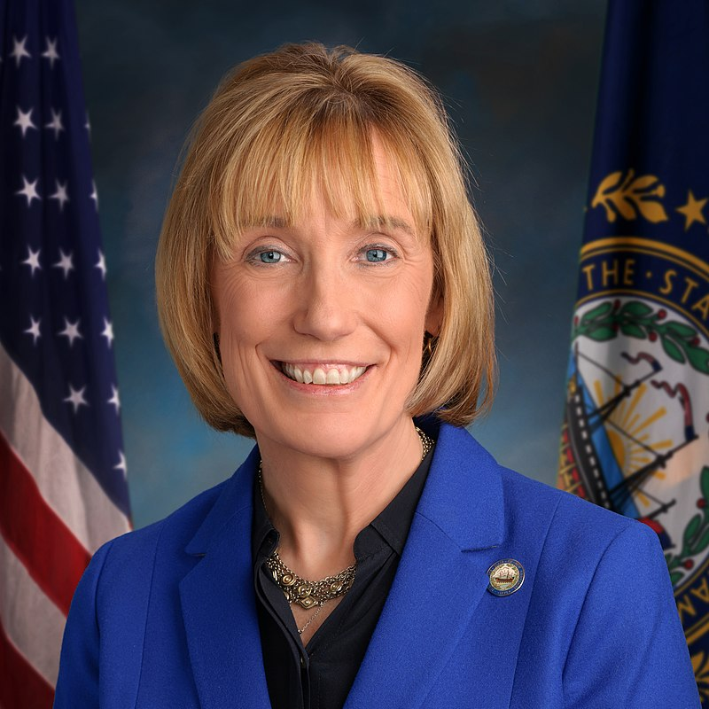
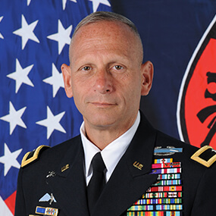
New Hampshire
Sen. Maggie Hassan (D)
Rating: Tilt Democratic
Incumbent Maggie Hassan (D)
Beat Sen. Kelly Ayotte 48-48% in 2016 election
Republican Nominee
Brig. Gen. (ret) Don Bolduc
Won GOP primary 37-36% over Chuck Morse
Baseline performance:
Democratic 50 %
Republican 47%
*Baseline is a metric developed by Inside Elections that calculates generic party
performance over the last four election cycles (2014-2020)

Slide 14
Ohio
Sen. Rob Portman (R)
Rating: Lean Republican
Incumbent Rob Portman (R) not seeking re-election
Republican Nominee
Author J.D. Vance
Won primary with 30%
Democratic Nominee
Rep. Tim Ryan
Won primary with 70%
Baseline performance:
Republican 55%
Democratic 43%
*Baseline is a metric developed by Inside Elections that calculates generic party performance over the last four election cycles (2014-2020)

Slide 15
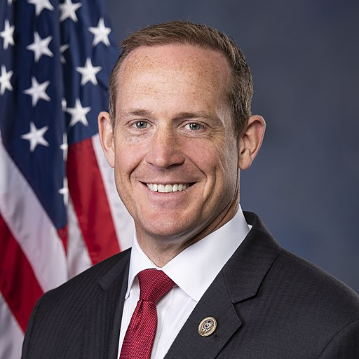
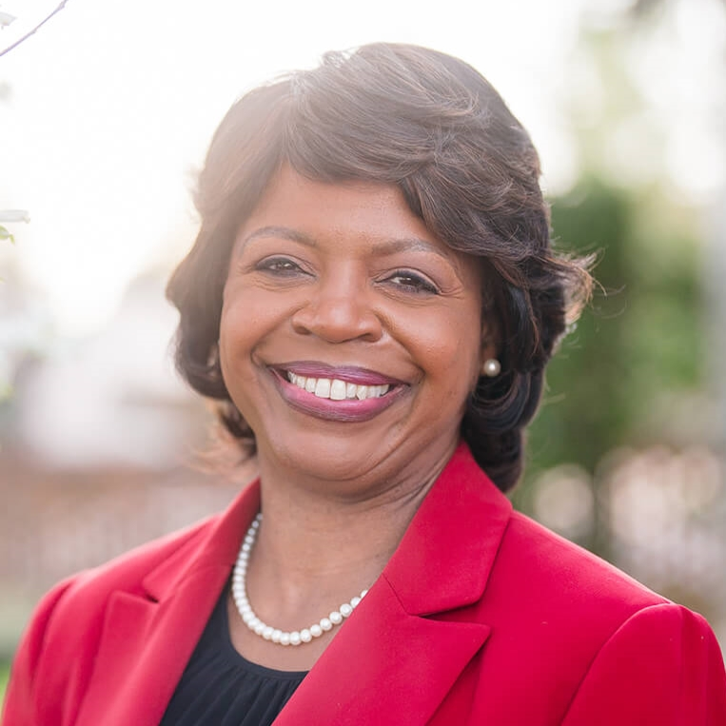
North Carolina
Sen. Richard Burr (R)
Rating: Tilt Republican
Incumbent Richard Burr (R) not seeking re-election
Republican Nominee
Rep. Ted Budd
Won primary with 59%
Democratic Nominee
Former state Supreme Court Chief Justice Cheri Beasley
Won primary with 81%
Baseline performance:
Republican 51%
Democratic 48%
*Baseline is a metric developed by Inside Elections that calculates generic party performance over the last four election cycles (2014-2020)

Slide 16
Colorado
Sen. Michael Bennet (D)
Rating: Likely Democratic
Incumbent Michael Bennet (D)
Beat Darryl Glenn 50-44% in 2016 election
Republican Nominee
Construction company CEO Joe O’Dea
Won primary with 55%
Baseline performance:
Democratic 50%
Republican 46%
*Baseline is a metric developed by Inside Elections that calculates generic party
performance over the last four election cycles (2014-2020)

Slide 17
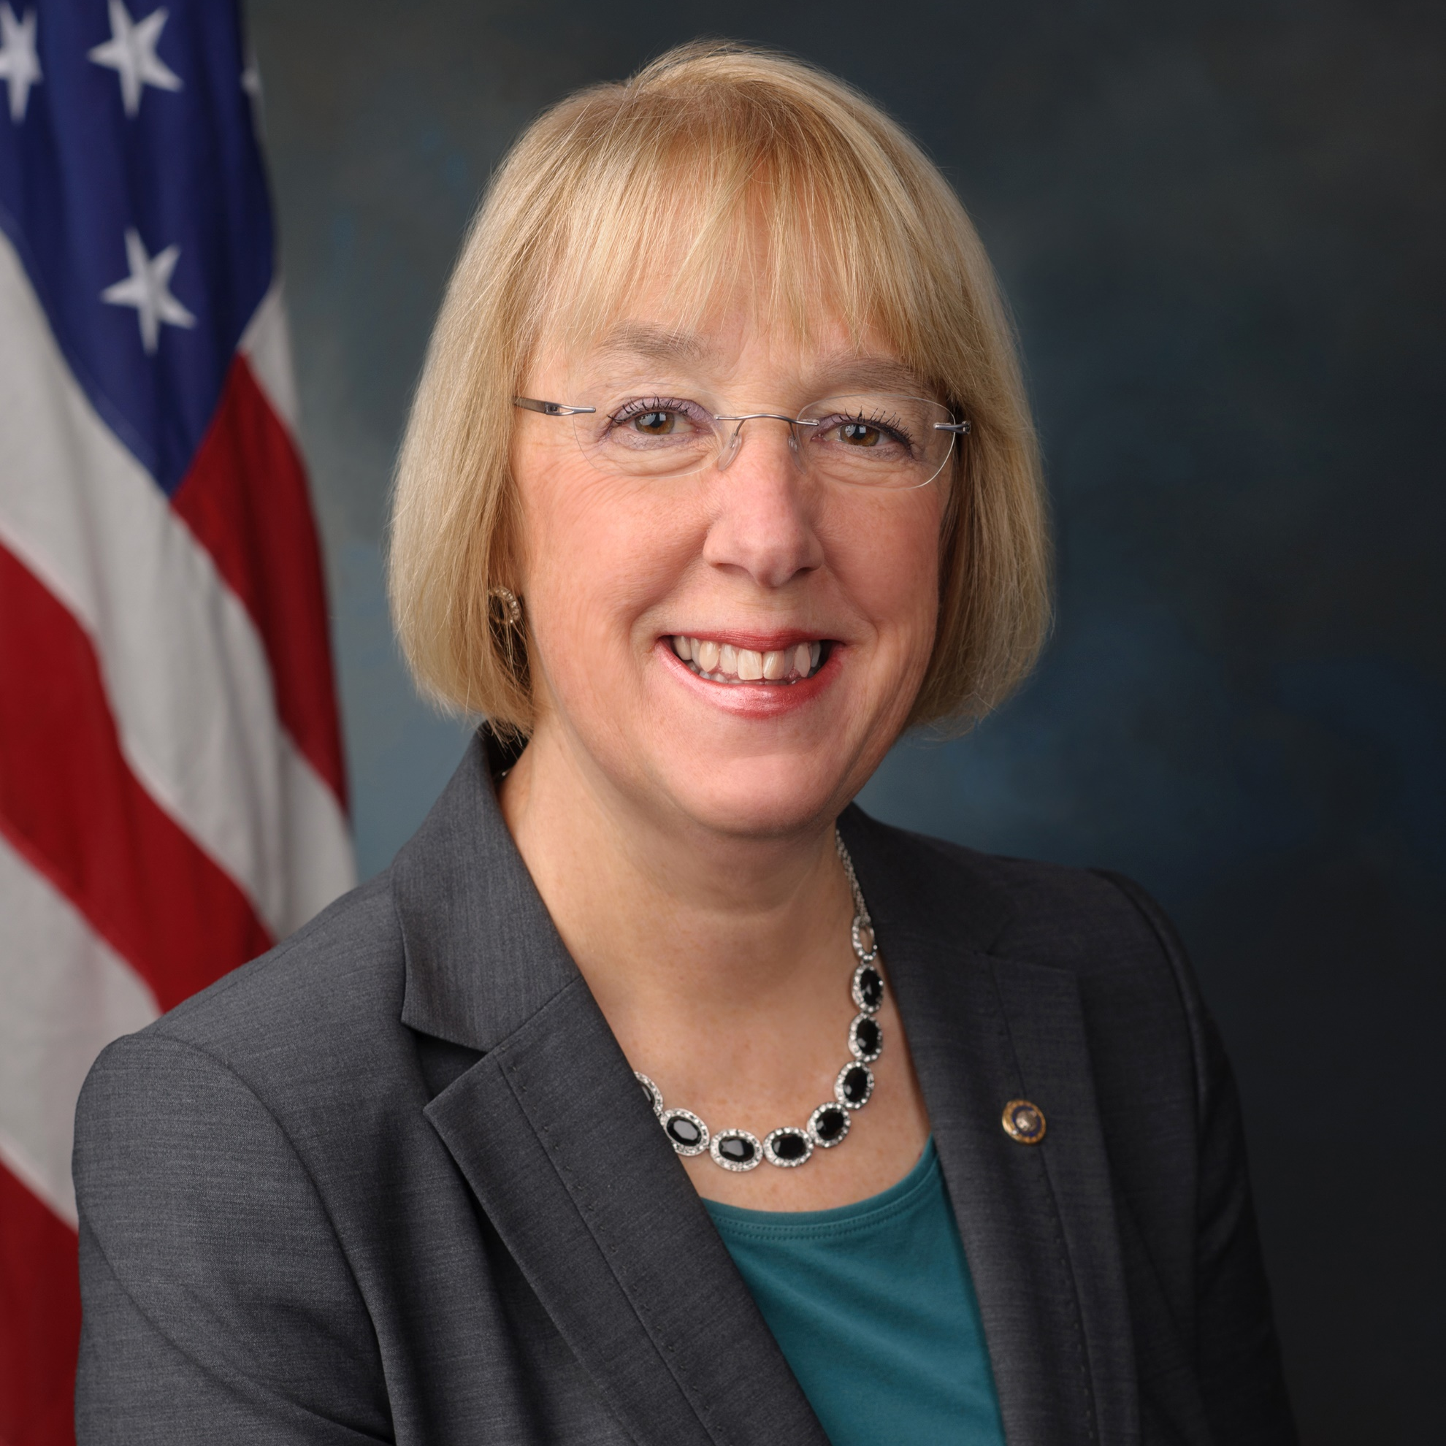
Washington
Sen. Patty Murray (D)
Rating: Likely Democratic
Incumbent Patty Murray (D)
Beat Chris Vance 59-41% in 2016 election
Republican Nominee
Triage nurse Tiffany Smiley
Baseline performance:
Democratic 56%
Republican 43%
*Baseline is a metric developed by Inside Elections that calculates generic party
performance over the last four election cycles (2014-2020)

Slide 18
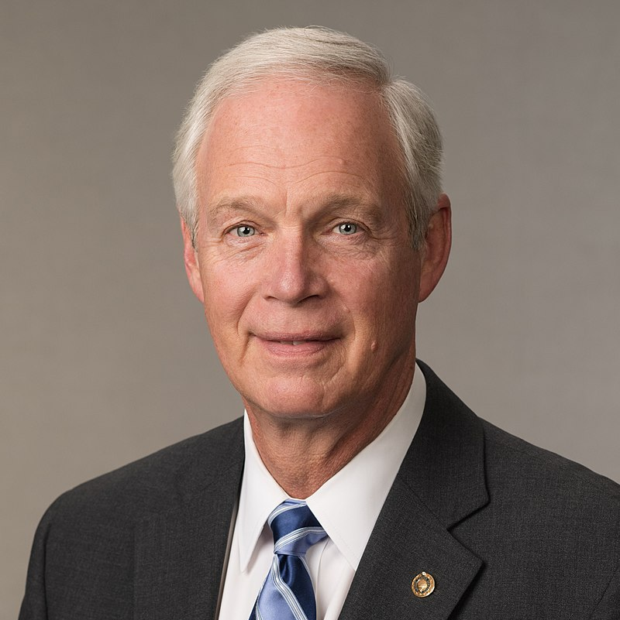
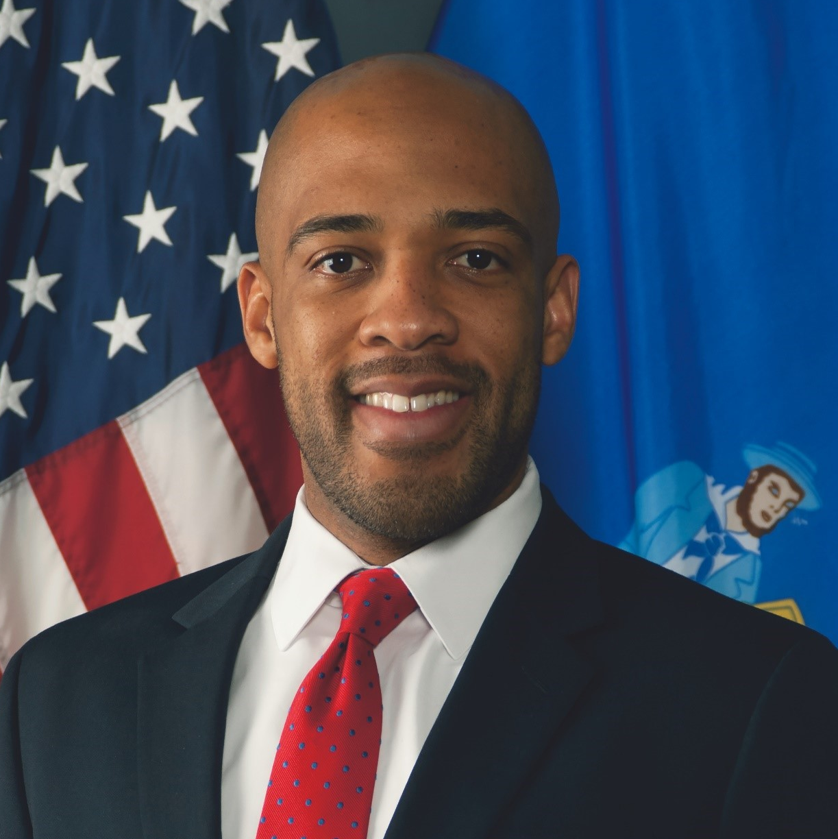
Wisconsin
Sen. Ron Johnson (R)
Rating: Tilt Republican
Incumbent Ron Johnson (R)
Beat former Sen. Russ Feingold 50-47% in 2016 election
Democratic Nominee
Lt. Gov. Mandela Barnes
Won primary with 78%
Baseline performance:
Republican 49%
Democratic 49%
*Baseline is a metric developed by Inside Elections that calculates generic party
performance over the last four election cycles (2014-2020)

Slide 19
Fight for the House

Slide 20
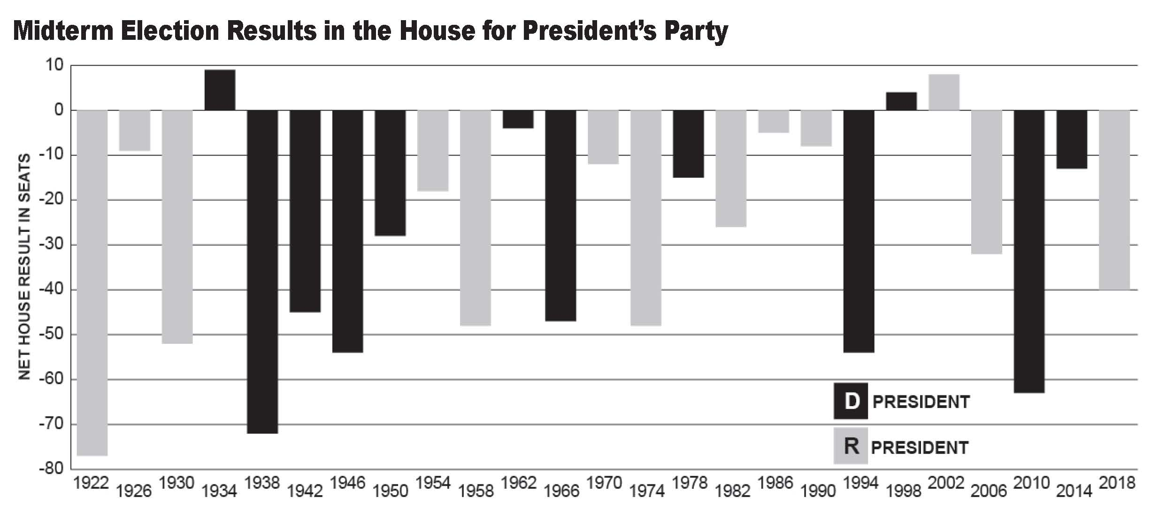
Midterm Trend: House Races

Slide 21
2022 House Races
Democrats
Republicans
LIKELY D
LEAN D
TILT D
TOSS UP
TILT R
LEAN R
LIKELY R
AZ 4 – Stanton
CA 9 – Harder
CA 26 – Brownley
CO 7 – (Perlmutter)
IL 6- Casten
IL14 – Underwood
MD 6 – Trone
NC 1 – (Butterfield)
NJ 3 – Kim
NH 2 – Kuster
NY 25 – Morelle
PA 12 – (Doyle)
VA 10 – Wexton
AK AL – Peltola
IN 1 – Mrvan
MI 8 – Kildee NV 4 – Horsford
OH 9 – Kaptur
TX 28 – Cuellar
CA 47 – Porter
CA 49 – Levin
IL 13 – (R. Davis)
KS 3 – Davids
ME 2 – Golden
MI 3 – (Meijer)
MI 7 – Slotkin
NH 1 – Pappas
NV 1 – Titus
NV 3 – Lee
NY 3 – (Suozzi)
NY 4 – (Rice) NY 18 – Ryan
OR 4 – DeFazio
VA 7 – Spanberger
CA 13 – (Harder)
CA 22 – Valadao
CT 5 – Hayes
IL17 – (Bustos)
MN 2 – Craig
NC 13 – (Open)
NE 2 – Bacon
NM 2 – Herrell
NY 17 – Maloney
NY 19 – (Ryan)
NY 22 – (Katko) OH 1 – Chabot
OH 13 – (Ryan)
OR 6 – NEW
PA 7 – Wild
PA 8 – Cartwright
PA 17 – (Lamb)
RI 2 – (Langevin)
TX 34 – Flores
WA 8 - Schrier
AZ 6 – (Kirkpatric)
CO 8 – NEW
CA 27 – Garcia
IA 2 – Hinson
IA 3 – Axne
NJ 7 – Malinowski
OR 5 – (Schrader)
VA 2 – Luria
AZ 1 – Schweikert
AZ 2 – O’Halleran
CA 45 – Steel
FL 13 – (Crist)
IA 1 – Miller-Meeks
MI 10 – (Levin)
MT 1 – NEW
NY 1 – (Zeldin)
NY 2 – Garbarino
TX 15 – (V. Gonzalez)
WA 3 – (Herrera Beutler)
WI 3 – (Kind)
CA 3 – (McClintock)
CA 40 – Kim
FL 5 – (Lawson)
FL 7 – (Murphy)
FL 15 – (Franklin) FL 27 – Salazar
GA 6 – (McBath)
NY 11 – Malliotakis
TN 5 – (Cooper)

Slide 22
The Big Picture
199 races currently rated Solid, Likely, Lean, or Tilting Democratic
216 races currently rated Solid, Likely, Lean, or Tilting Republican
20 pure Toss-ups
Current projection: GOP net gain of 13-30 seats
218 seats needed for a majority

Slide 23
Fight for the Governors

Slide 24
2022 Governors Races
Democratic Seats: 16
Republican Seats: 20
SOLID D
LIKELY D
LEAN D
TILT D
TOSS UP
TILT R
LEAN R
LIKELY R
SOLID R
LEAN D
CA – Newsom
CO – Polis
CT – Lamont
HI – Open (Ige)
IL – Pritzker
RI – McKee
MA – Open
(Baker)
MD – Open (Hogan)
NY – Hochul
ME – Mills
PA – Open (Wolf)
MI – Whitmer
NM – Lujan Grisham
AZ – (Ducey)
NV – Sisolak
KS – Kelly
WI – Evers
OR – Open (Brown)
GA – Kemp
AK – Dunleavy
FL – DeSantis
OK – Stitt
AL – Ivey
AR – Open (Hutchinson)
ID – Little
IA – Reynolds
NE – Open (Ricketts)
NH – Sununu
OH – DeWine
SC – McMaster
SD – Noem
TN – Lee
TX – Abbott
VT – Scott
WY - Gordon

Slide 25
For more information contact:
nathan@insideelections.com InsideElections.com | @InsideElections | @nathanlgonzales

