Slide 1
Meag power Business update jim fuller, President & CEO
2022 Mayors Summit

Slide 2
Meag power update & outlook
What’s on Today’s Program
Board, Management Leadership
Update on Vogtle Units 3 & 4, and GPC Settlement
Energy Trends - Inflation Reduction Act
Integrated Resource Plans
Southeast Energy Exchange Market (SEEM)
Legislative Update

Slide 3
What’s on tap today
A number of excellent presentations
With Election Day only 3 days away, we have lined up:
Brian Robinson to discuss the Georgia political landscape
Nathan Gonzales to discuss the national political outlook
And with so much happening in our industry, we have:
Joy Ditto, CEO of the APPA, to discuss the outlook for Public Power
Robert Bryce to address the energy industry outlook and trends

Slide 4
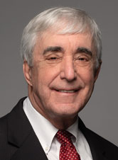
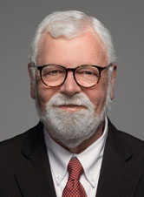
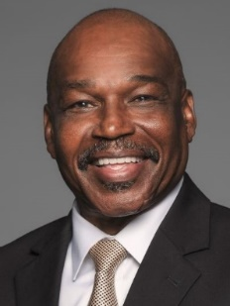
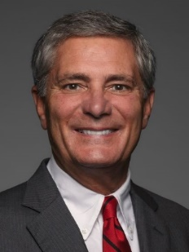
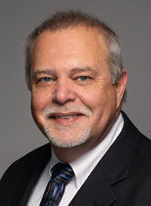
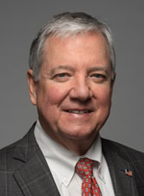
Current meag power board members
Representation From Around the State
R. Steve “Thunder” Tumlin, Jr.
Chairman Mayor, Marietta
Larry M. Vickery
Vice Chairman, General Manager Calhoun Utilities
L. Timothy Houston, Sr.
Secretary-Treasurer
Alderman, Acworth
Patrick C. Bowie, Jr.
Utility Director, LaGrange
L. Keith Brady
Mayor, Newnan
Terrell D. Jacobs
Muni. Ops. Consultant, GMA
Eric S. Wilson
Mayor, Forsyth
Gregory P. Thompson
Businessman, Monroe
William J. Yearta
State Representative, Sylvester
Notes:
9 Board Members; 3 year terms; elected at MEAG Power Annual Meeting; must reside in a MEAG city.

Slide 5
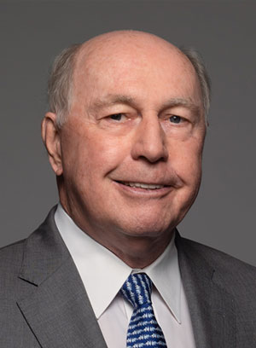
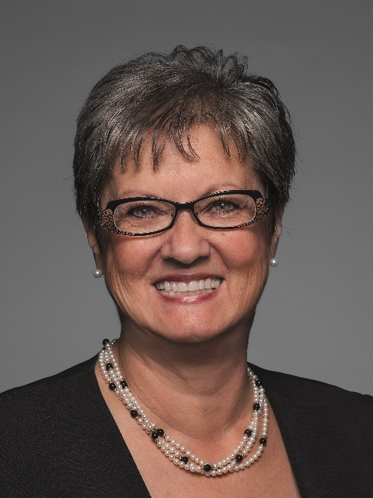
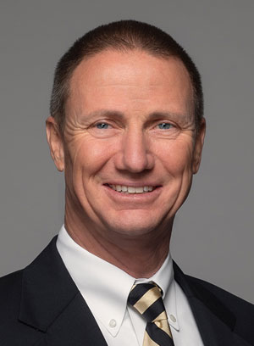
veteran executive team
Pete Degnan
Senior Vice President & General Counsel
Steve Jackson
Senior Vice President & Chief Operating
Officer
Reiko Kerr
Senior Vice President & Chief Financial Officer
Doug Lego
Vice President & Chief Administrative Officer

Slide 6
Added executive depth and strength
22 years of utility industry experience in public power
Most recently at the Los Angeles Department of Water and Power (LADWP)
Senior Assistant General Manager
Riverside Public Utilities (RPU) in Riverside, Calif.
16 years in exec. positions, including serving as CFO
Reiko Kerr
Welcome to MEAG Power, Reiko!

Slide 7
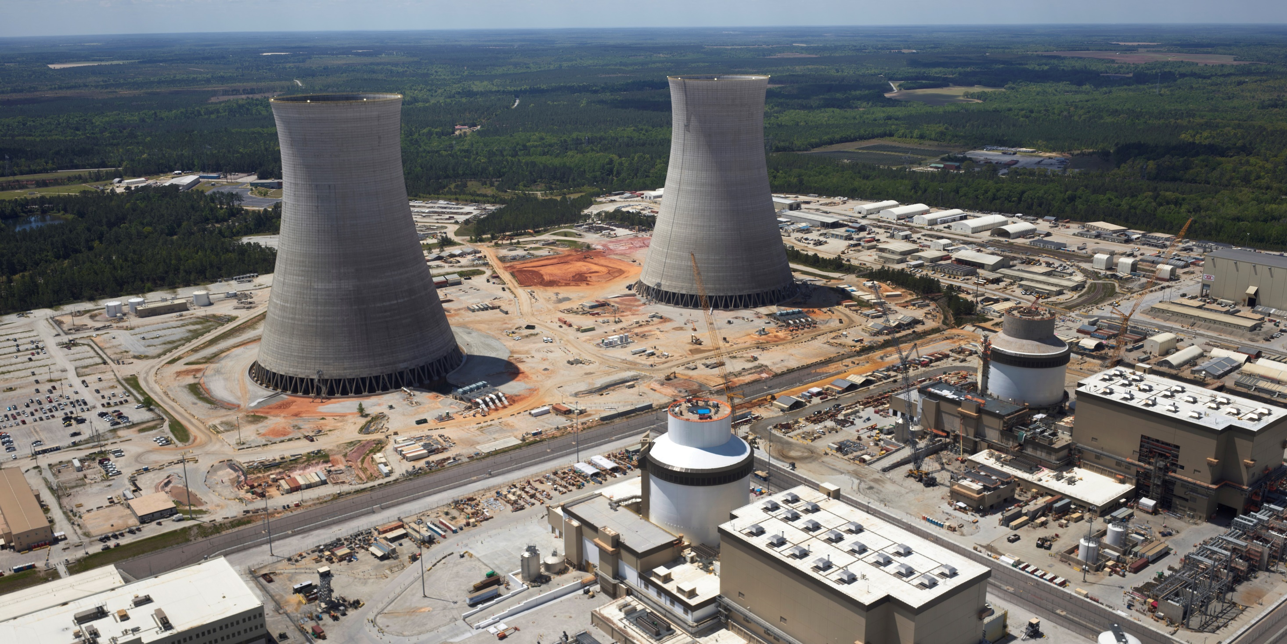
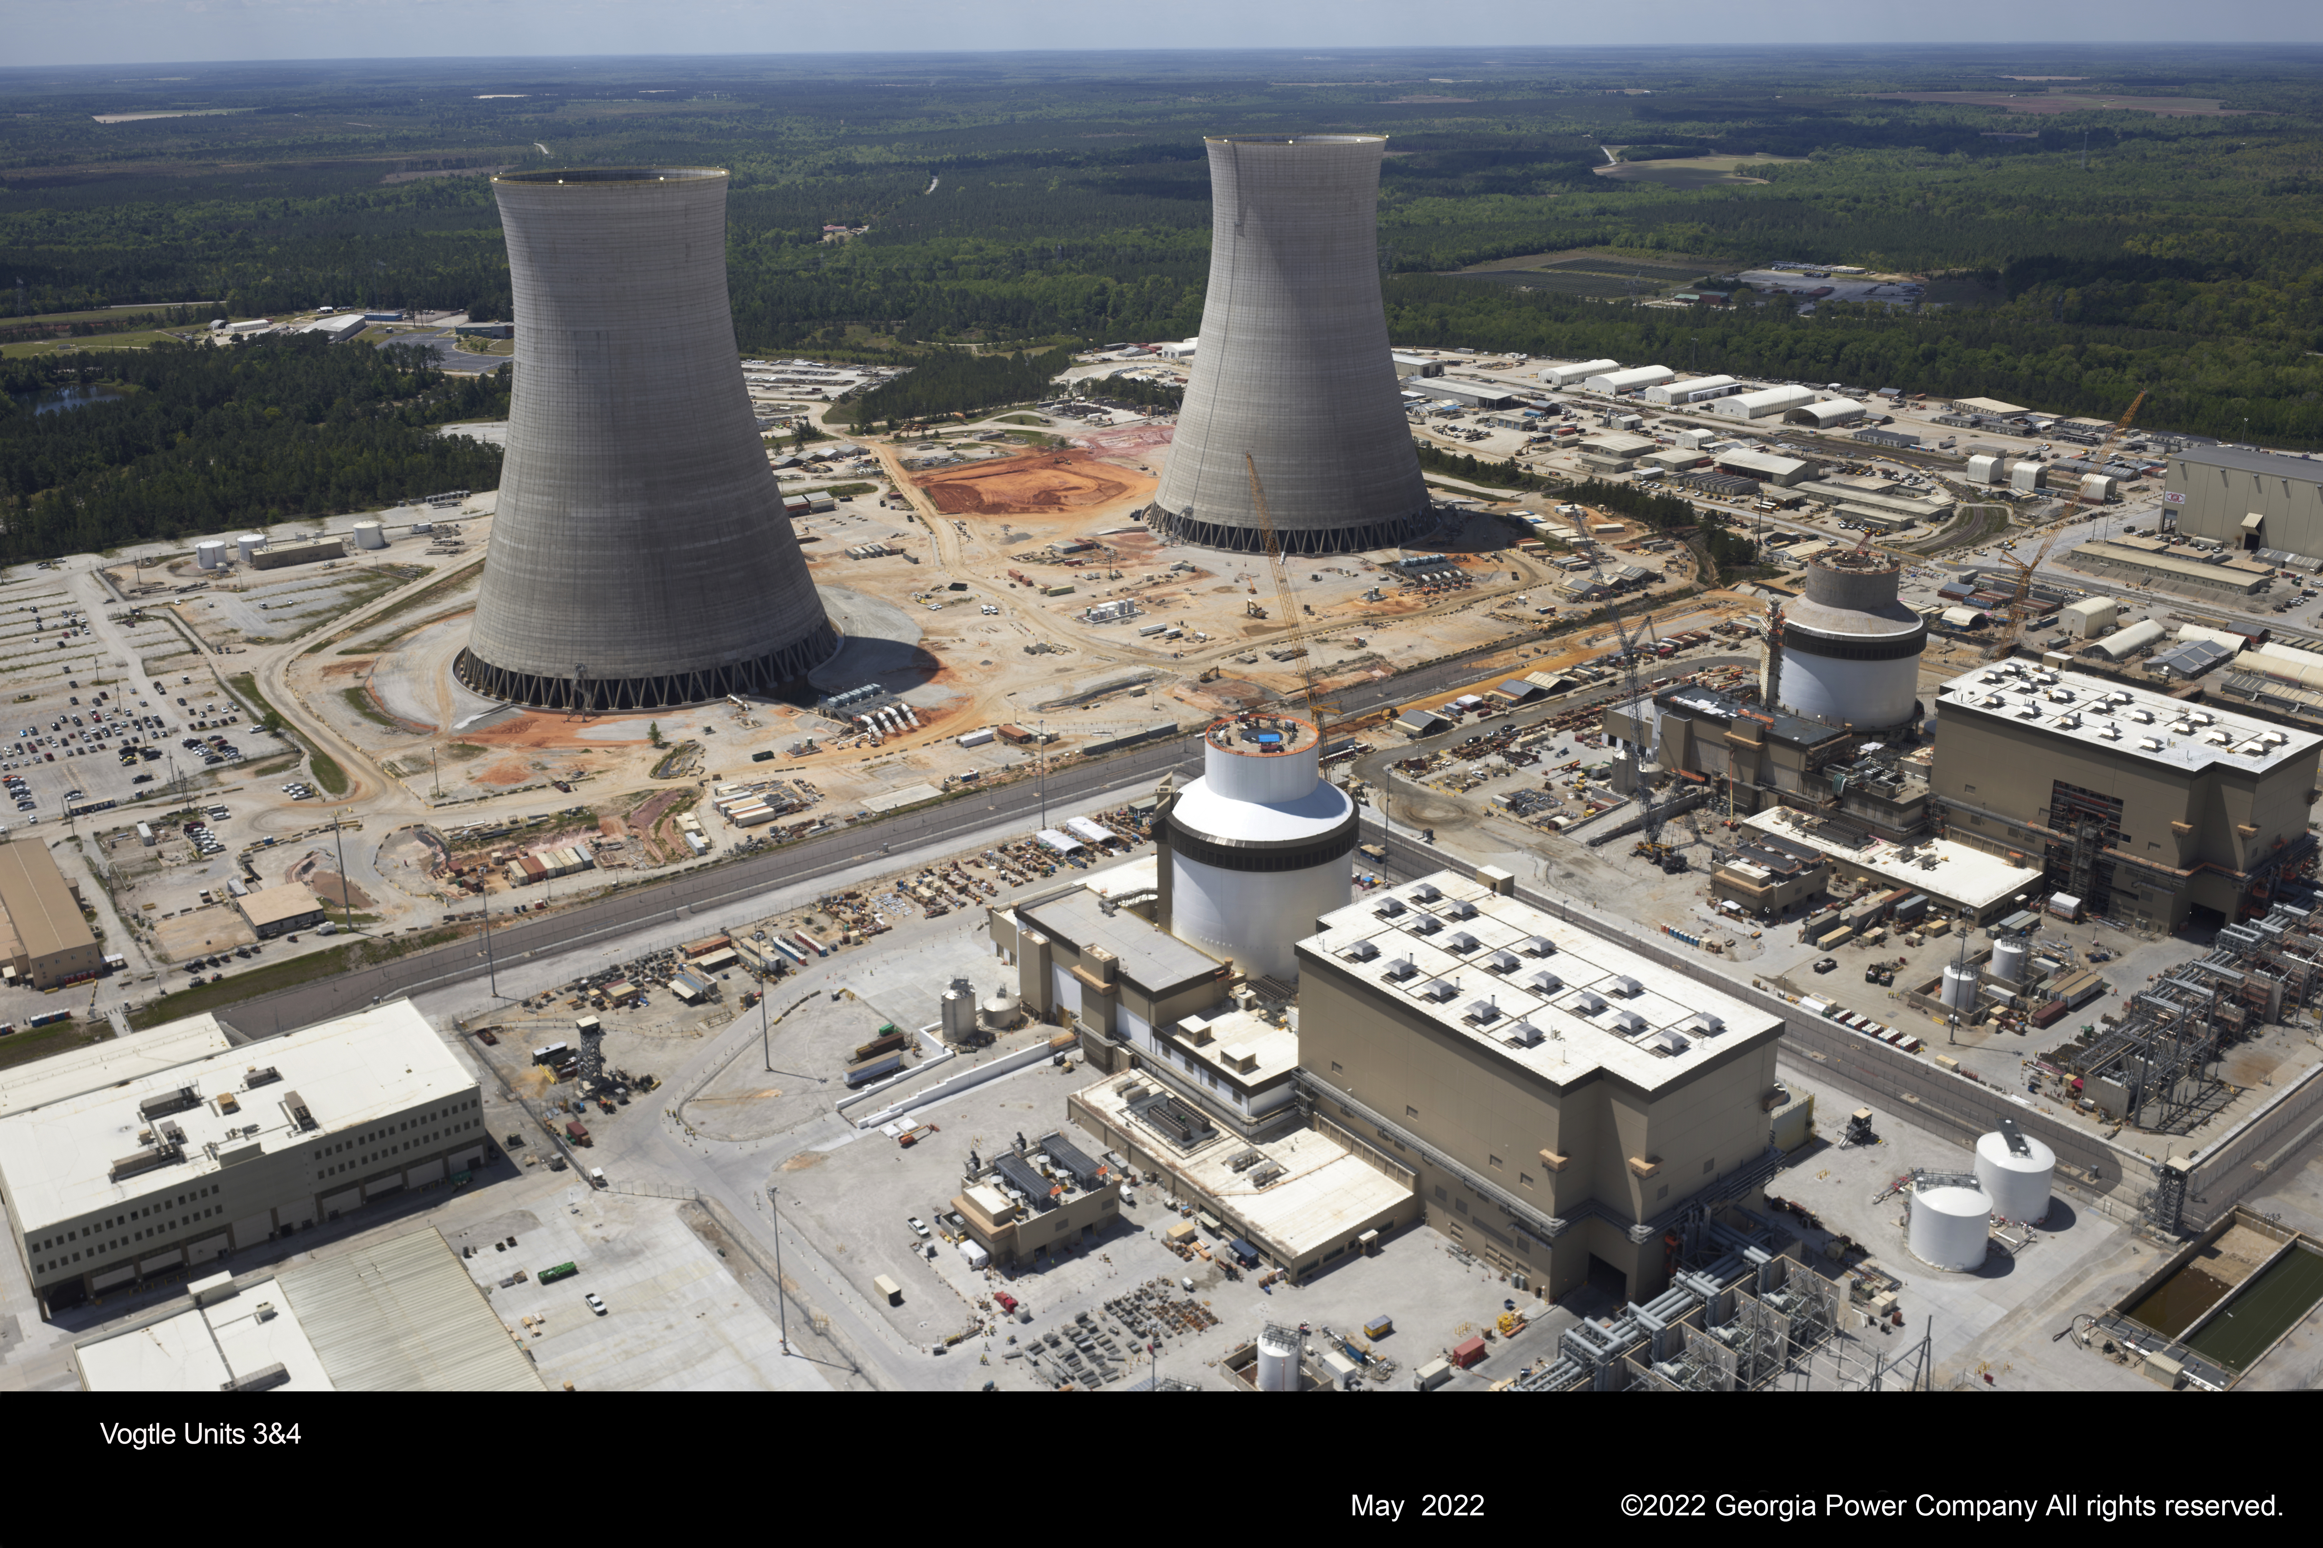
VOGTLE UNITS 3 & 4 project updates

Slide 8
What vogtle 3&4 will deliver
Clearly, there have been enormous challenges…
But now we’re just months away from:
Up to 80 years of non-emitting baseload power
500 MW of clean energy added to the grid by both units
A huge accomplishment made even more important in the context of today’s energy industry and economy

Slide 9
Vogtle PROJECT UPDATE – Unit 3
Aug. 3 Unit 3 received the 103(g) finding from the Nuclear Regulatory Commission (NRC)
Signifying readiness to load fuel and begin startup sequence
Unit 3 now managed as operating unit
Security integration is complete; Units 1-3 security integrated before fuel load
Turning over systems from testing to operations
Fuel load took place October 14

Slide 10
Vogtle PROJECT UPDATE – Unit 3
Unit 3 commercial operation date expected first quarter 2023
Multiple weeks of testing between fuel load and COD
Following six specific modes …

Slide 11
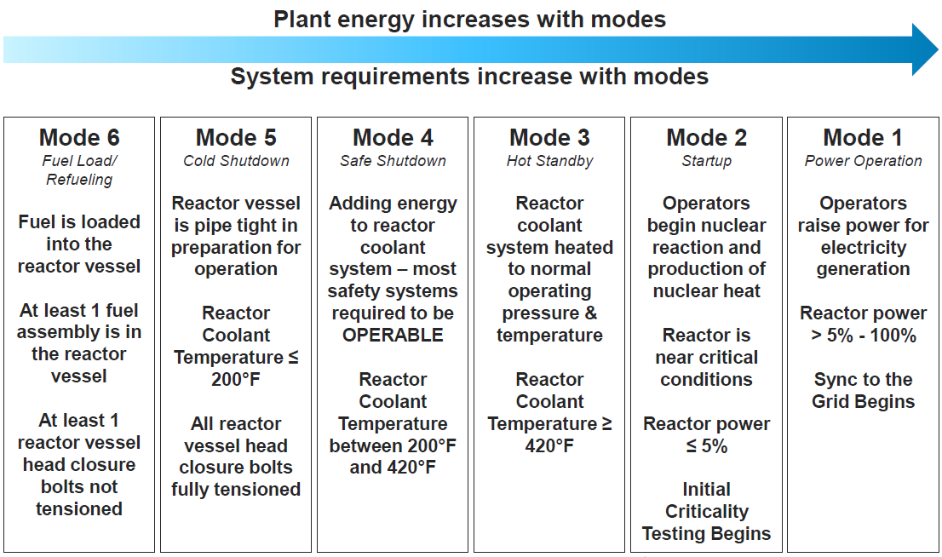
VOGTLE UNIT 3 UPDATE
Notes:
Reactor vessel assembly complete
Unit 3 entered Mode 5 on November 2nd

Slide 12
Vogtle PROJECT UPDATE – Unit 3
Georgia Power filed Vogtle Construction Monitoring report (VCM-27) with GPC October 27
Project schedule remains unchanged:
COD for Unit 3 end of first quarter 2023
COD for Unit 4 end of fourth quarter 2023

Slide 13
Vogtle PROJECT UPDATE – Unit 4
Unit 4 testing ramping up. Upcoming milestones:
closed vessel testing
cold hydrostatic testing
hot functional testing
Electrical work remains a focus
Lessons learned from Unit 3 continue to be applied
A few more photos…

Slide 14
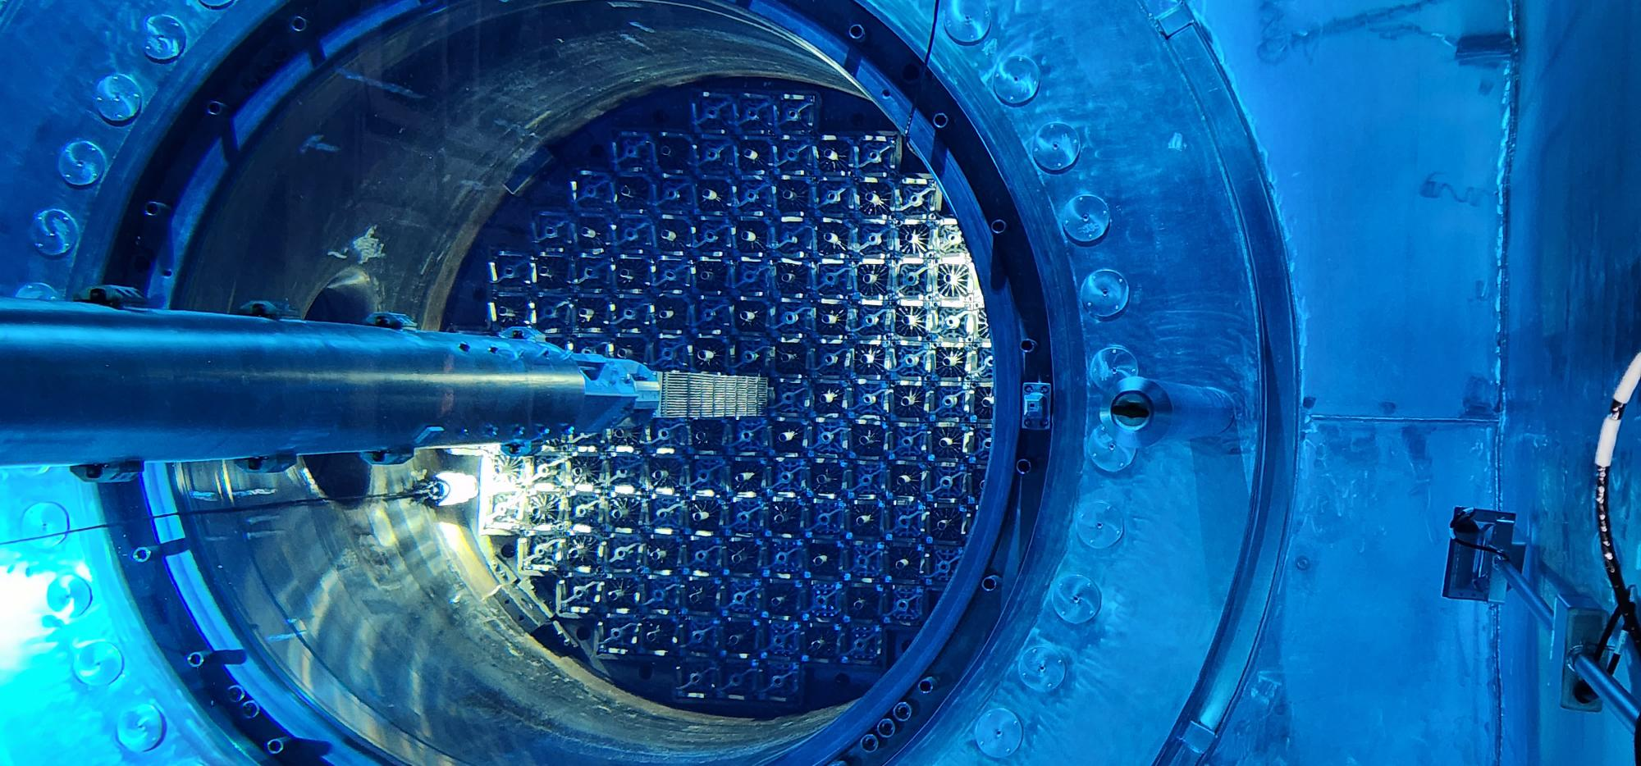
Unit 3 fuel load – last assembly

Slide 15
Unit 3 containment & Turbine Buildings

Slide 16
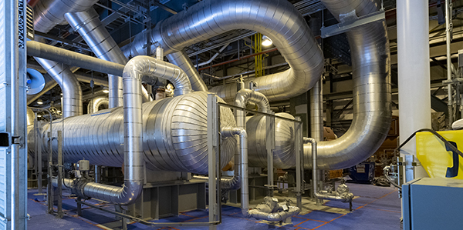
Unit 3 turbine building

Slide 17
Unit 4

Slide 18
Vogtle GPC lawsuit settled
In June MEAG Power and its wholly owned subsidiaries (Projects J, M and P) filed suit seeking clarification of GPC’s cost responsibility and ownership tender rights
In late Sept. reached settlement agreement with GPC
Very favorable resolution for the MEAG Power Participant communities, MEAG Power, its wholly owned subsidiaries and off-takers

Slide 19
Vogtle GPC lawsuit settled
The settlement will pay the full amount that MEAG Power claimed under the lawsuit plus the additional 20 percent of our costs over and above the agreement reached in 2018, while MEAG Power retains its full 22.7 percent ownership in Vogtle Units 3&4
GPC will reimburse the Project Entities for:
15% of their share of the actual cost of construction of Vogtle Units 3&4 in excess of $18.7 billion, up to and including $19.6 billion, and
20% of their share of the actual cost of construction of Vogtle Units 3&4 in excess of $19.6 billion

Slide 20
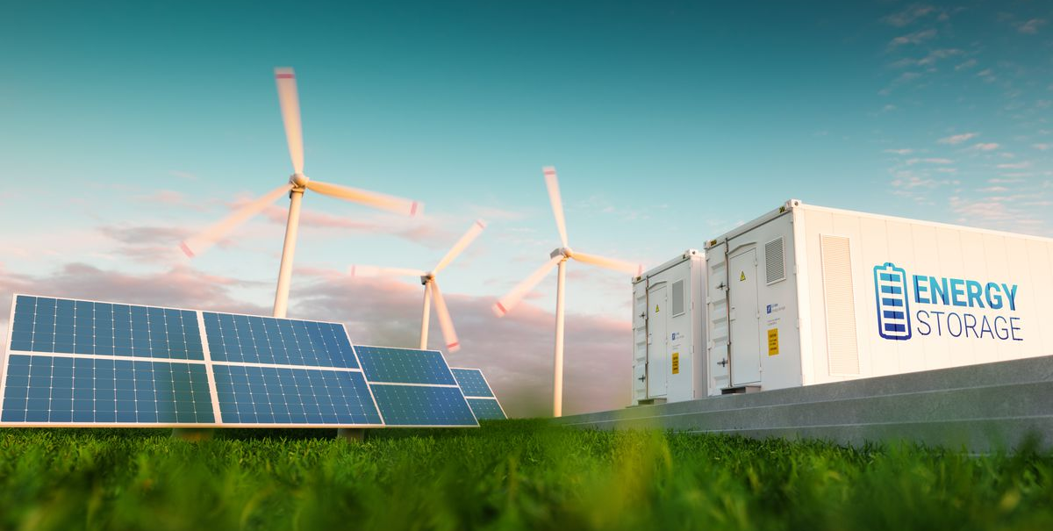
Energy trends

Slide 21
Energy trends
Natural gas prices the key driver of the energy market
August prices the highest of the year
Since April, well above budget
Falling prices forecast to continue
for several months
Coal availability is another significant driver
Coal generation limited due to
retirements & low inventory
Limits the ability to switch from gas to coal generation
Helping gas demand remain strong even with high prices

Slide 22
Energy costs well above budget

Slide 23
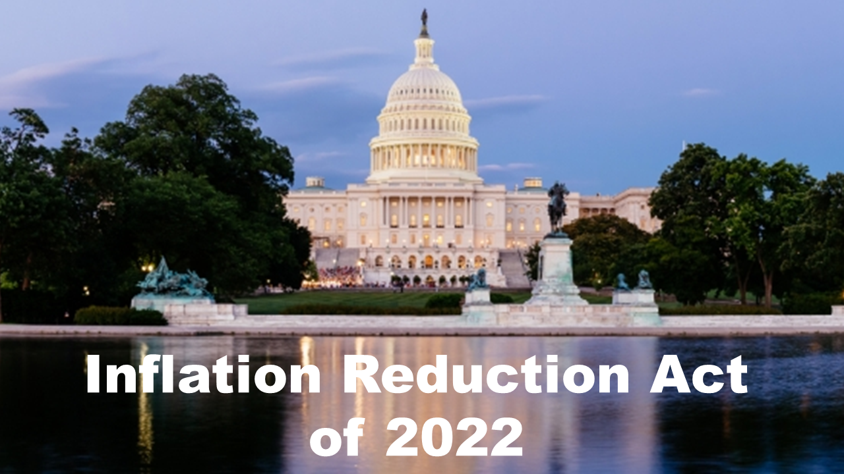
Inflation reduction act (IRA)

Slide 24
Inflation reduction act (IRA)
IRA establishes direct-pay tax credit for tax-exempt entities
Public Power has long supported this approach
Nuclear production tax credits on Vogtle project helped pave the way
Gives Public Power utilities option to own solar facilities
No longer restricted to power purchase agreements to obtain tax incentives
IRA also includes tax credit for existing nuclear facility owners
Base credit is 0.3 cents/kWh; bonus credit of 1.5 cents/kWh available under certain conditions
MEAG Power working with APPA and LPPC to analyze potential

Slide 25
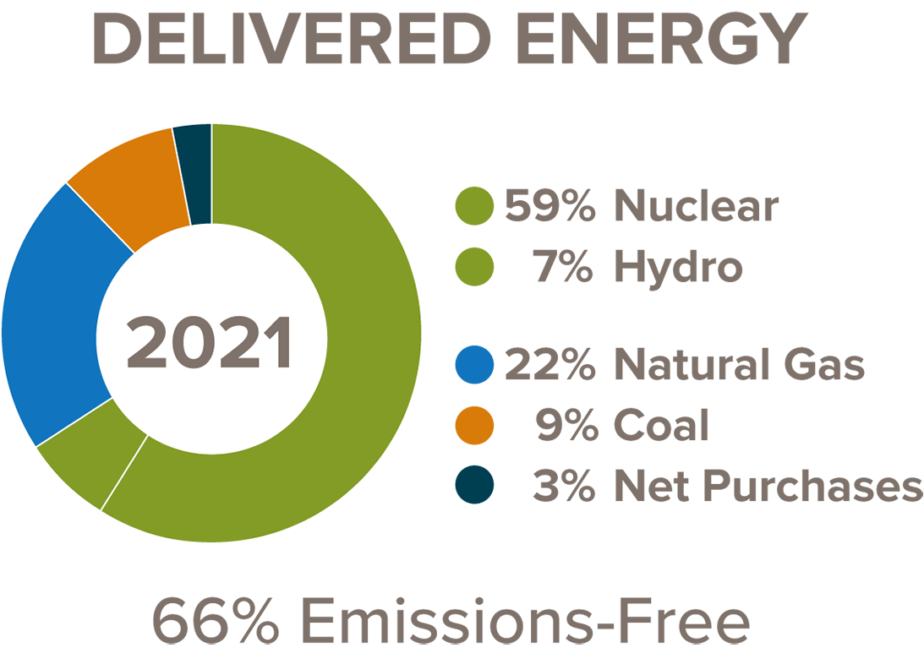
2020 Integrated resource plan
IRP Approved in 2020
Roadmap to meet Participant requirements
25-year study period; focus on 10 years of actionable alternatives
MEAG Power already favorably positioned

Slide 26
2020 integrated resource plan
Put in place a series of steps
Lessening reliance on coal and exiting Plant Wansley in 2022
Renewing license to operate both Plant Hatch units an additional 20 years
Integrating Plant Vogtle 3&4 output when units enter operation
Moving forward with our first solar initiative

Slide 27
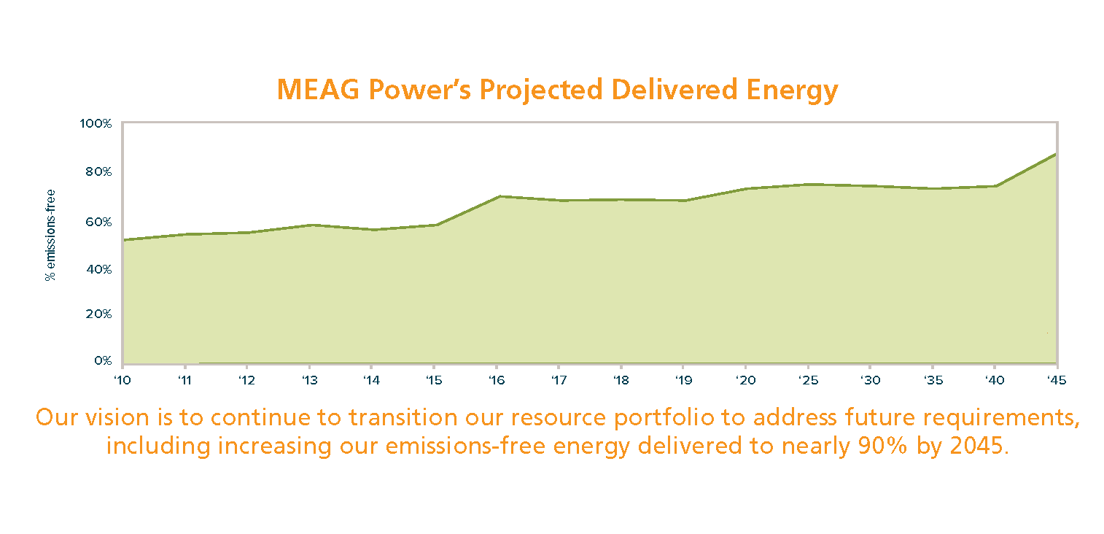
Integrated resource plan

Slide 28
IRP to be Updated in 2023
IRPs planned to be updated every 3 years
MEAG Power’s IRP will be updated in mid-2023
Assessing IRA’s impact on:
Solar ownership, direct pay vs. PPA
Existing nuclear ownership tax credit
Fine-tuning plans for the future of Plant Scherer
Addressing power supply needs related to:
EV charging/fleet growth potential
Overall electrification
Other areas

Slide 29
Seem – southeast energy exchange market
Approved by FERC in October 2021
Expected to begin service this coming
Wednesday, Nov. 9
SEEM will be:
a 15-minute energy exchange market
Buy and sell power close to time energy consumed
Benefits to MEAG Power:
Better manage balance between load and resources
Reducing any penalty charges under GPC scheduling agreement

Slide 30
Seem – southeast energy exchange market
The SEEM footprint now includes:
23 entities in parts of 12 states across two time zones
More than 180,000 MWs (summer capacity; winter capacity is nearly 200,000 MWs)
These companies serve the energy needs of more than 36 million retail customers (nearly 60 million people).
In October, 4 Florida energy companies joined

Slide 31
Legislative update
During 2021-2022 session, several net metering bills introduced
Would tilt the playing field further toward rooftop solar industry
None passed, but we expect further net metering bills in the next biennial session
As always, we encourage Participant engagement to voice opposition to such legislation
Without further Congressional action, your voice may be needed to help protect the federal subsidy received on Build America Bonds

Slide 32
Thank you!

