Slide 1
A Question Of Power:
What’s Next For Electric Grids?
Robert Bryce presentation to:
MEAG Power
Braselton, GA
November 5, 2022
Notes:
A brief history of electricity
Global look at electricity

Slide 2
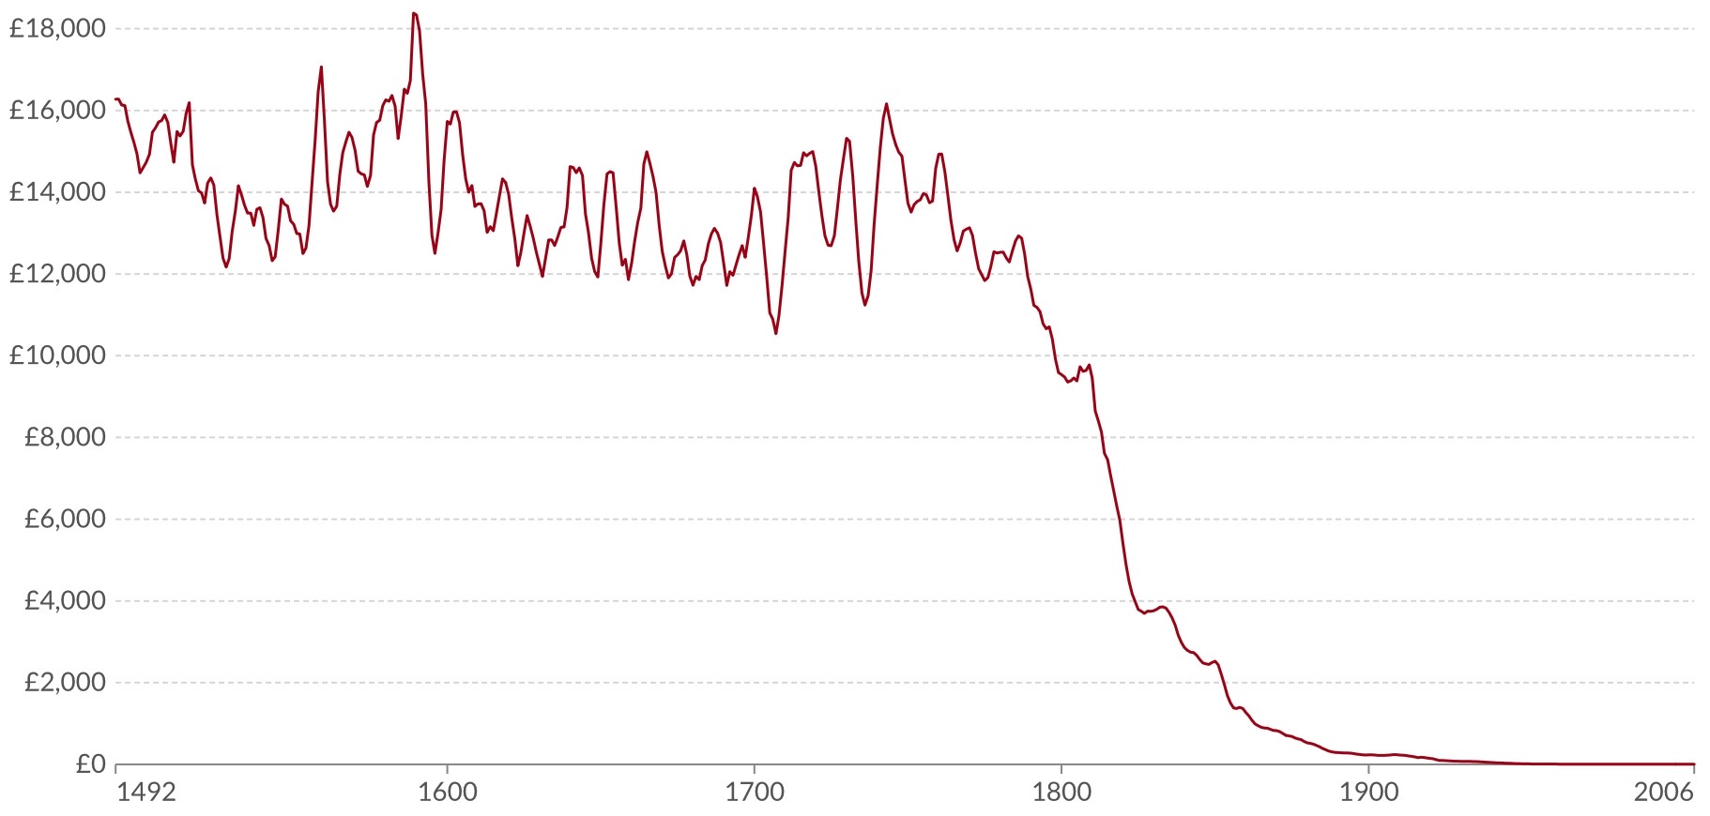
Price For Lighting in the UK, 1492 to 2006
Price per million lumen-hours in inflation-adjusted British Pounds
Source: Our World In Data, https://ourworldindata.org/grapher/the-price-for-lighting-per-million-lumen-hours-in-the-uk-in-british-pound
© Robert Bryce
Notes:
Gutenberg gave books to the people.
Edison, Steinmetz, Tesla, Westinghouse, Sprague, Insull, and many others made electricity cheap enough that poor folks could read books at night.
That changed the world.
"We will make electric light so cheap that only the rich will be able to burn candles.
World history has two epochs: The Electric Age and everything that came before the Electric Age.
Electricity ignited innovation like nothing else.
Electricity turbocharged the move toward SFLDC in everything.

Slide 3
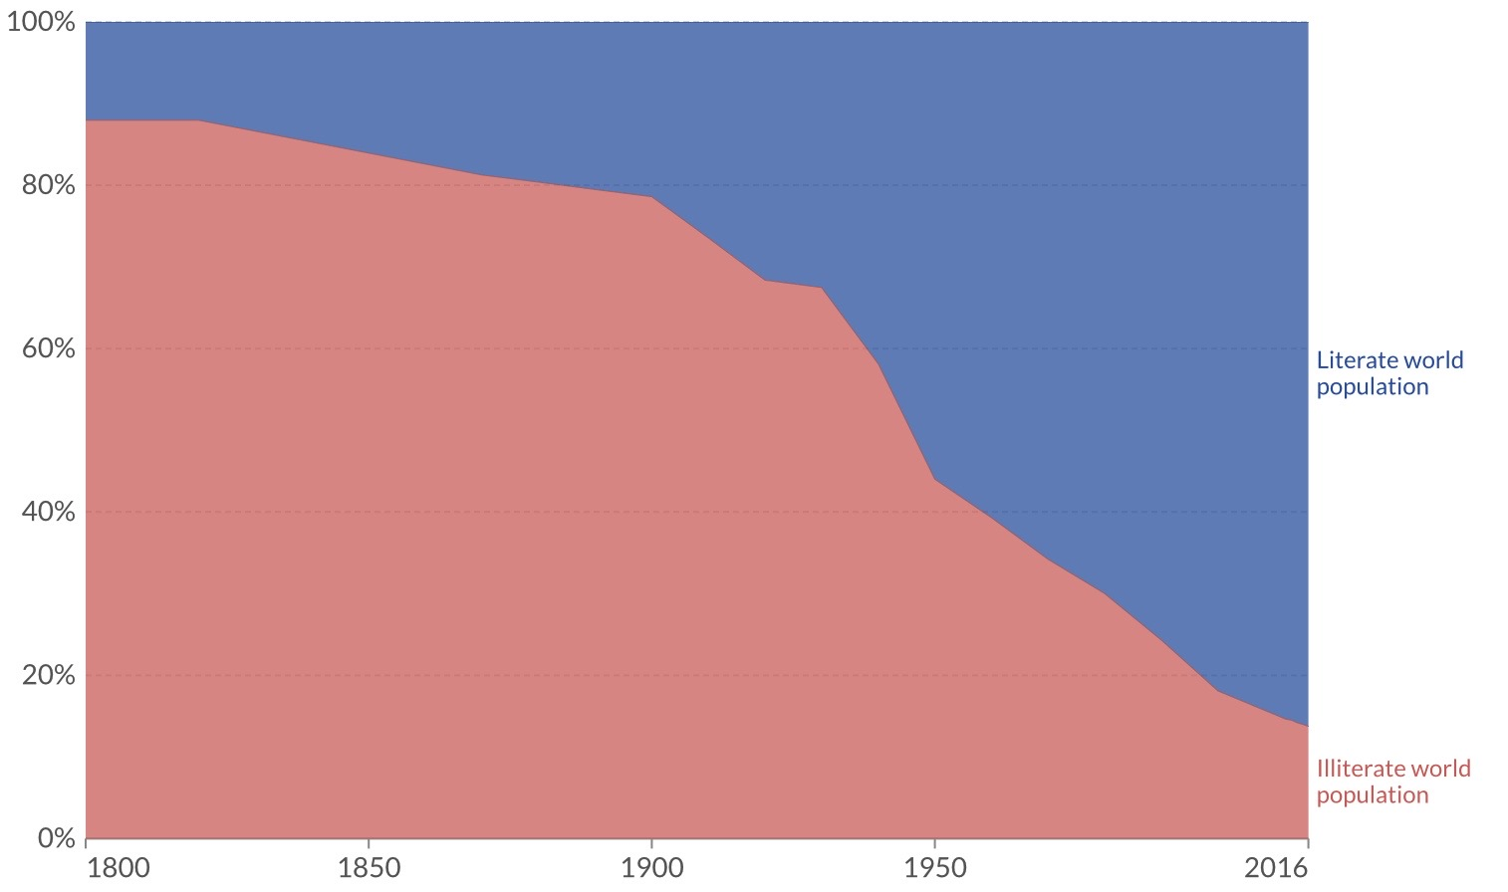
Literate and Illiterate World
Population, 1800 to 2016
Source: Our World In Data, https://ourworldindata.org/literacy
Notes:
In 1800, about 10 percent of the world was literate. By 1900, it was about 20%. By 1950, it was more than 50%.

Slide 4
Global GDP Over Last 2,000 Years
Trillion US Dollars Per Year, Adjusted For Inflation ($2011)
Source: Our World In Data, https://ourworldindata.org/economic-growth
© Robert Bryce

Slide 5
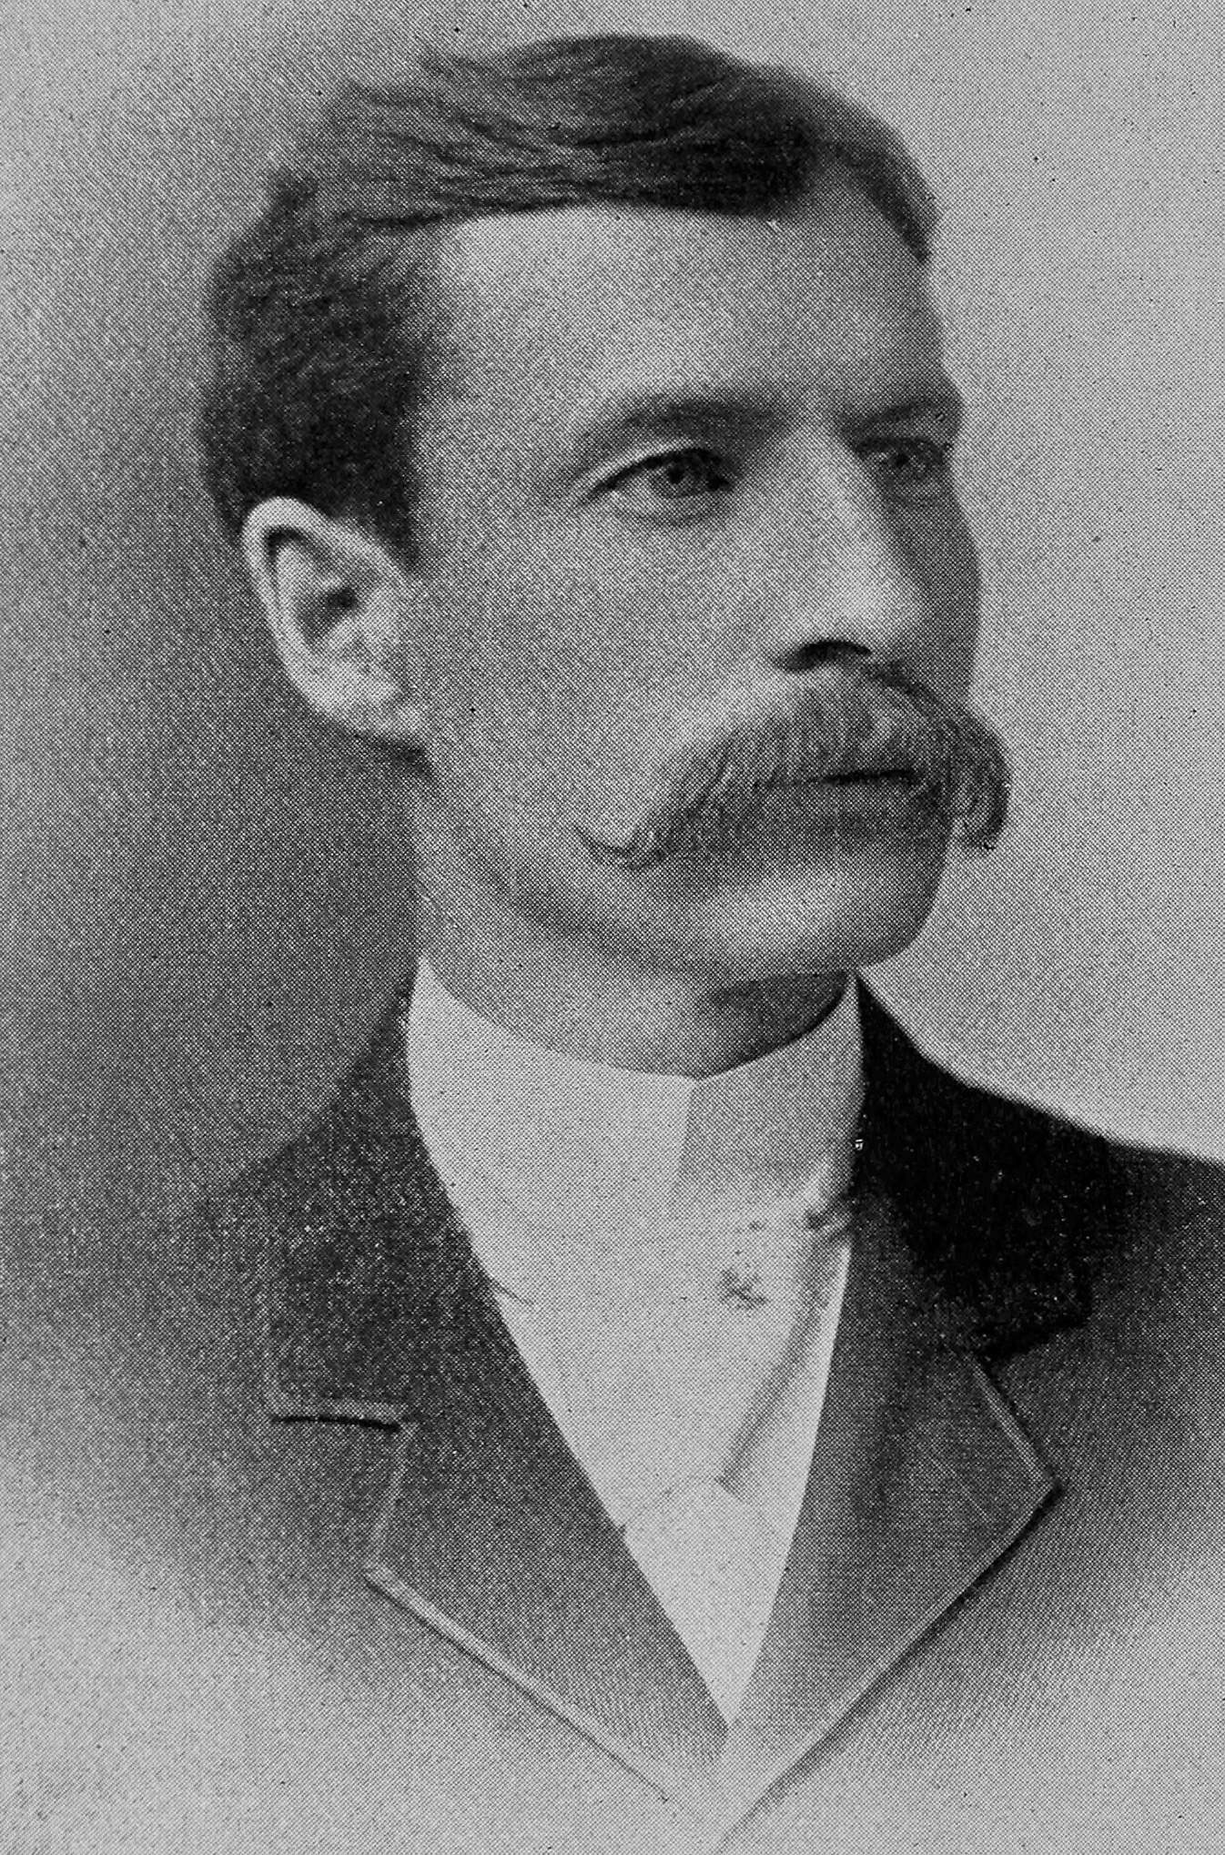
Edison and Sprague Electrified The World
Notes:
Seeing the promising future of electric power, mechanical engineer Frederick Sargent and electrical engineer Ayres Lundy had entered the field. In 1891, the two men partnered in Chicago to form their namesake company, Sargent & Lundy. Individually, they had already earned recognition for their technical talent and foresight. Sargent was one of Thomas Edison’s most capable early associates. Lundy was a highly regarded colleague of electric railway pioneer Frank Sprague.

Slide 6
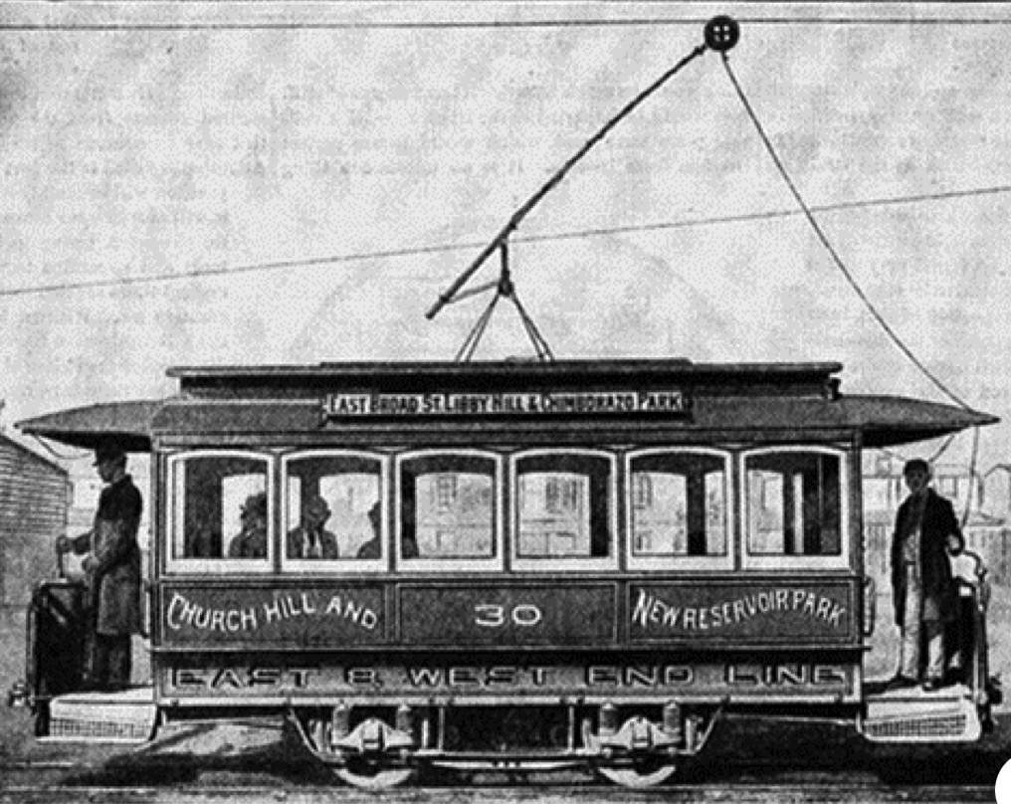

Frank Sprague Perfected Electric Streetcars In Richmond & Elevators In New York City
Notes:
Sprague perfected the first electric motors. He perfected the first electric street cars (in 1888 in Richmond, VA), and the first bank of electric elevators in 1894 at the Postal Telegraph Building at 253 Broadway, across from City Hall in NYC.
Those innovations birthed the modern vertical city.
Height is electrical.

Slide 7

Nicholas County, Kentucky, 1916
© Robert Bryce
Source: Library of Congress, https://www.loc.gov/item/2018678344/

Slide 8
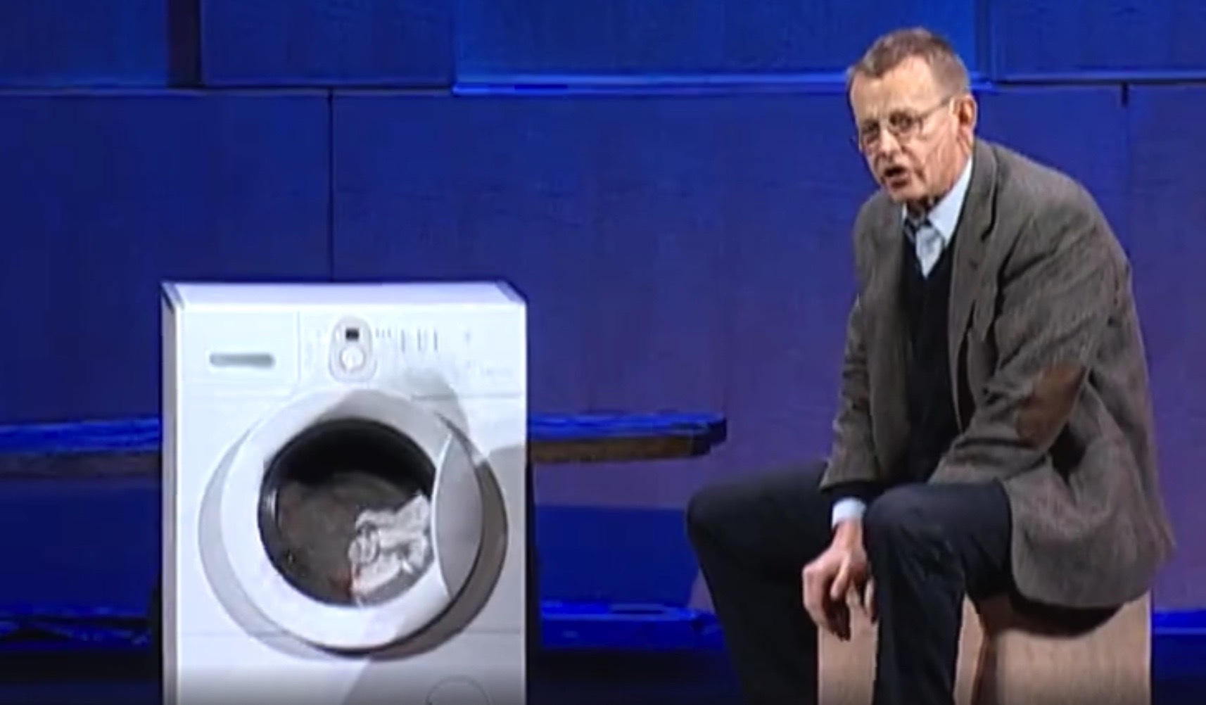
Hans Rosling: “To my grandmother,
the washing machine was a miracle”
Source: https://www.ted.com/talks/hans_rosling_the_magic_washing_machine?language=en

Slide 9


“Electricity is why we have modern cities,
height is electrical.”
Notes:
Those innovations birthed the modern vertical city.
Height is electrical.
Roickefeller Center on the left 66 stories. Burf Khalifa in Dubai, 163 stories.

Slide 10
Where Are We Today?
What Are The Key Challenges?
© Robert Bryce

Slide 11
1,000 kWh/yr =
1 US refrigerator
© Robert Bryce
Source: A Question of Power, World Bank

Slide 12
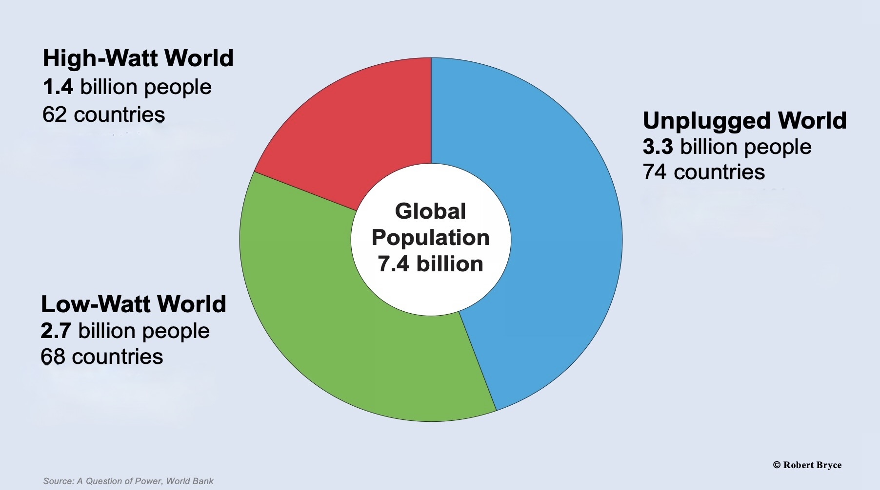
1,000 kWh/yr =
1 US refrigerator

Slide 13
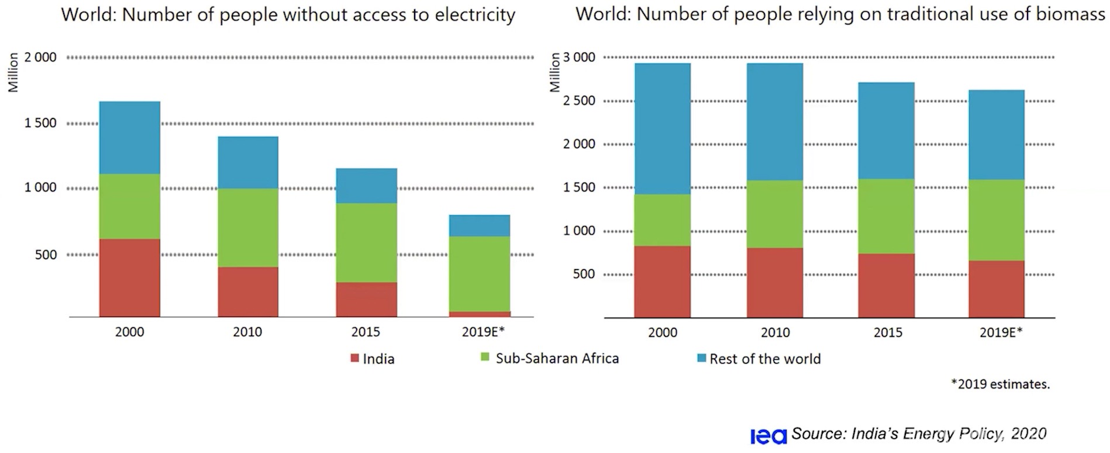
Plus, 2.5 Billion People Are Still Using Traditional Biomass!
Source: Stanford Gas Initiative, IEA

Slide 14
Electricity Generated by Region, 2021
TWh generated/year
Source: BP
© Robert Bryce

Slide 15
Global Electricity Production,
1985 to 2021
Average increase: +/- 500 TWh/yr
500 TWh/yr = 1 France
Source: BP
Terawatt-hours generated per year
© Robert Bryce

Slide 16
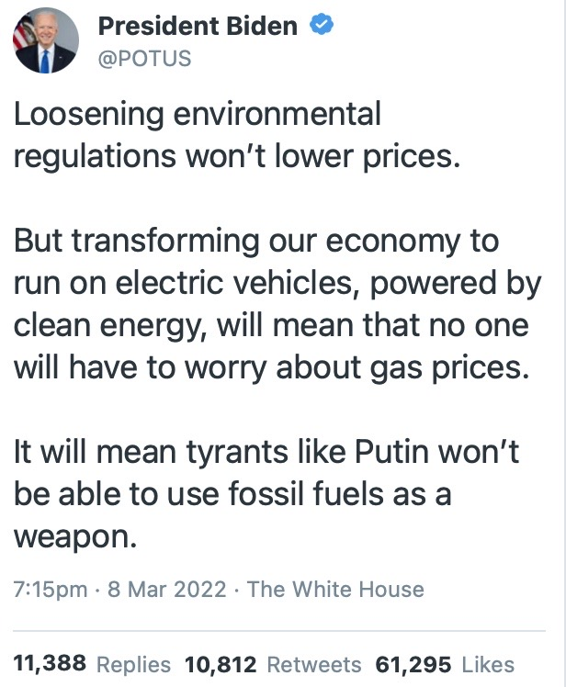
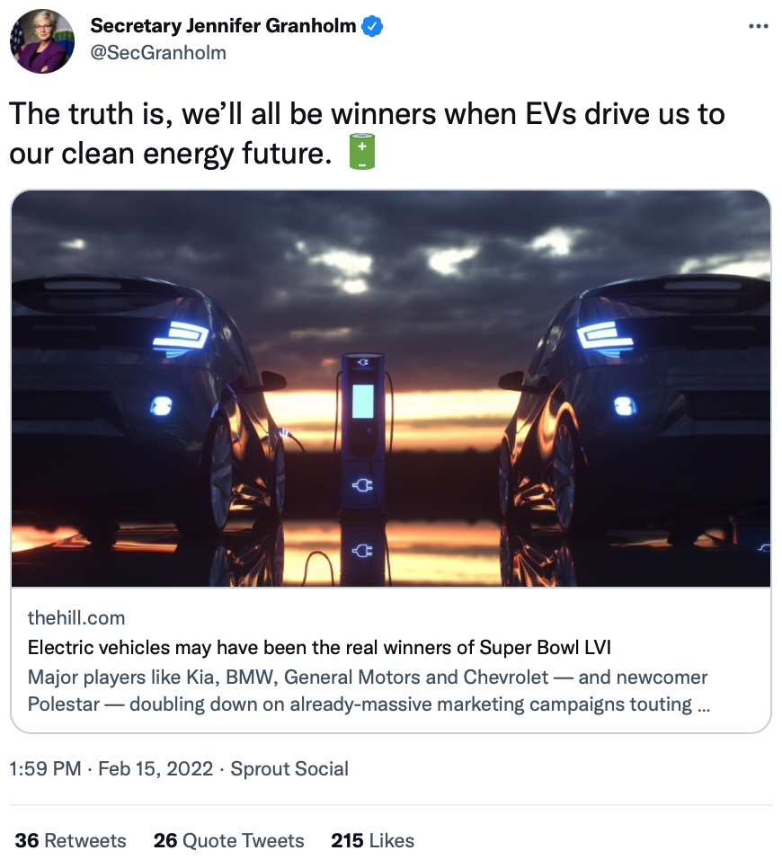
Source: Reuters, San Francisco Chronicle, EcoWatch, Yale Environment360
© Robert Bryce

Slide 17
Biden’s Zero-Carbon Grid Needs
2,700 TWh/yr Of New Zero-C Juice by 2035,
From Where Will It Come?
2021 Electricity Generation, Terawatt-hours
Source: BP.
© Robert Bryce
Notes:
NOT A WORD ABOUT NUCLEAR IN BIDEN’S STATE OF THE UNION.
US coal+gas = 16x US solar
= 7x US wind
= 1.5x global wind

Slide 18
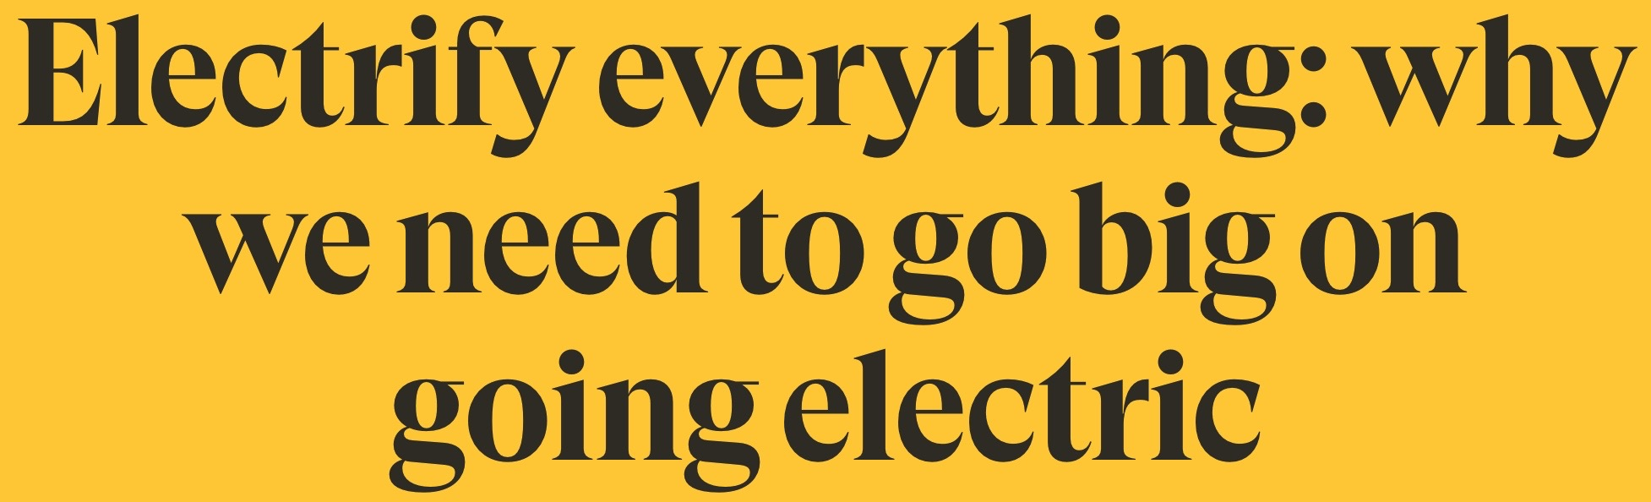

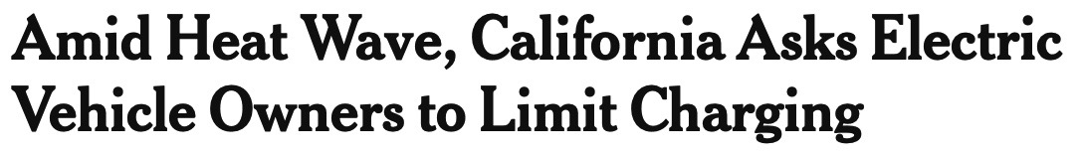

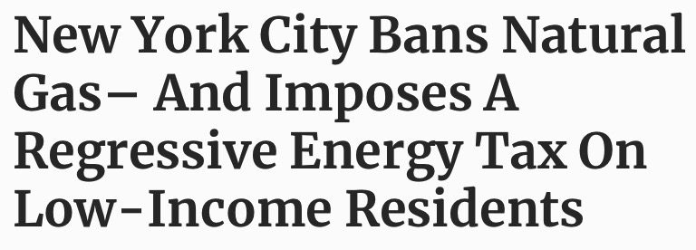
Electrify Everything?
EV Mandates & Natural Gas Prohibitions
Source: Reuters, San Francisco Chronicle, EcoWatch, Yale Environment360
© Robert Bryce

Slide 19
US Natural Gas Power Burn, 1997 to 2021
Enron Bankruptcy
Trillion cubic feet per year
Source: EIA, https://www.eia.gov/dnav/ng/ng_cons_sum_dcu_nus_a.htm
© Robert Bryce
Notes:
Too dependent on nat gas.
Just in time gas, intermittent renewables. Could result in blackouts.

Slide 20
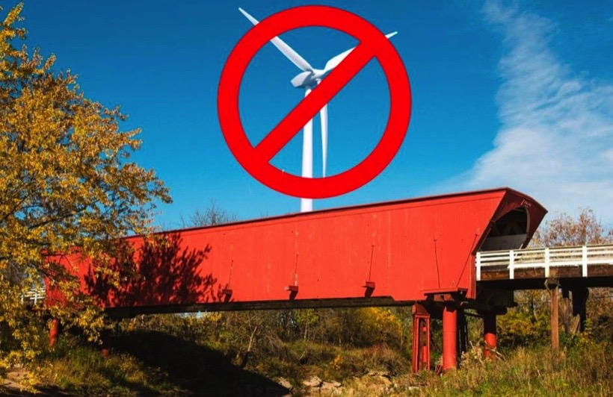

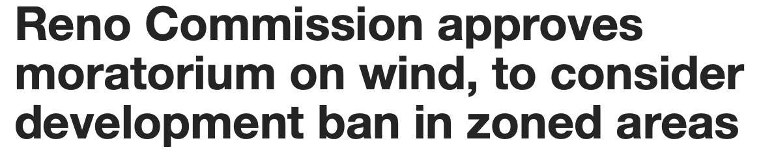

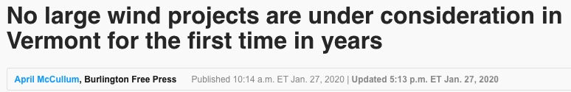
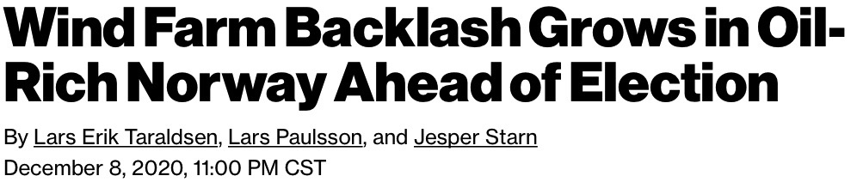
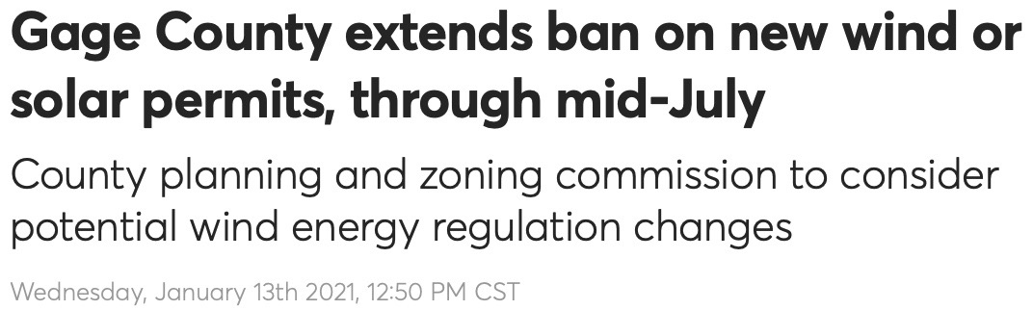
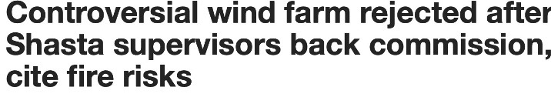
Big Wind: Friction From Norway to Nebraska
Source: Media outlets
© Robert Bryce

Slide 21
US Wind Energy Rejections, 2015 to 2022
At least 370 rejections or restrictions since 2015
Source: Renewable Rejection Database
© Robert Bryce
Notes:
Gage County, Nebraska.
Wheeler County, Nebraska
Madison County, IA

Slide 22

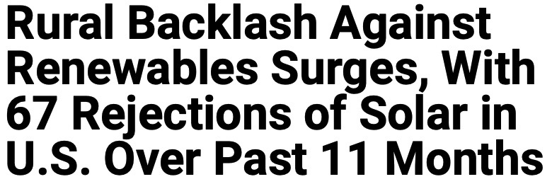





Big Solar’s Being Rejected, Too
Source: Renewable Rejection Database
© Robert Bryce
Notes:
Gage County, Nebraska.
Wheeler County, Nebraska
Madison County, IA

Slide 23
US Solar Energy Rejections, 2017 to 2022
More than 100 rejections or restrictions of solar energy since 2017
Source: Renewable Rejection Database
© Robert Bryce
Notes:
More than 40 of these in 2022 have happened in Ohio.

Slide 24
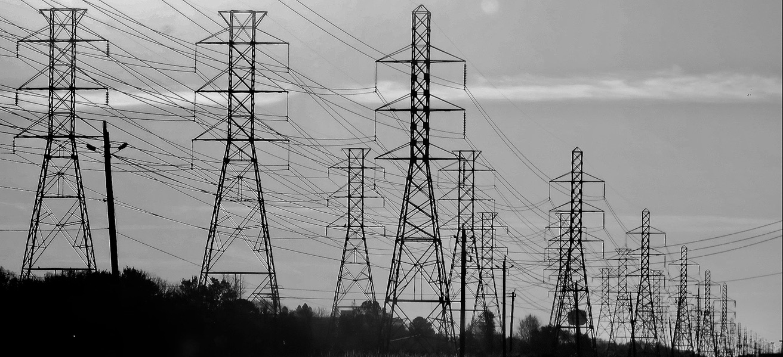
All-Renewable Schemes Require Massive Increases in High-Voltage Transmission...
● NREL: 90% renewable electricity requires doubling HV transmission
● US has 240,000 miles of HV transmission (230kV and up)
● From 2008 to 2021, US built 1,700 miles/year of HV transmission
● At that rate, doubling HV capacity will take 140 years!
Sources: NREL, C Three Group
© Robert Bryce
Notes:
This image is from a recent study published by PhDs at Princeton in December.
Existing capacity is about 320,000 GW-km.
In 20 years, the goal is to nearly quadruple HVDC capacity. Call me a skeptic.
New data, at current rates of construction, about 1700 miles per year for 230 kV and above, it will take about 140 years to double our HV transmission network.

Slide 25
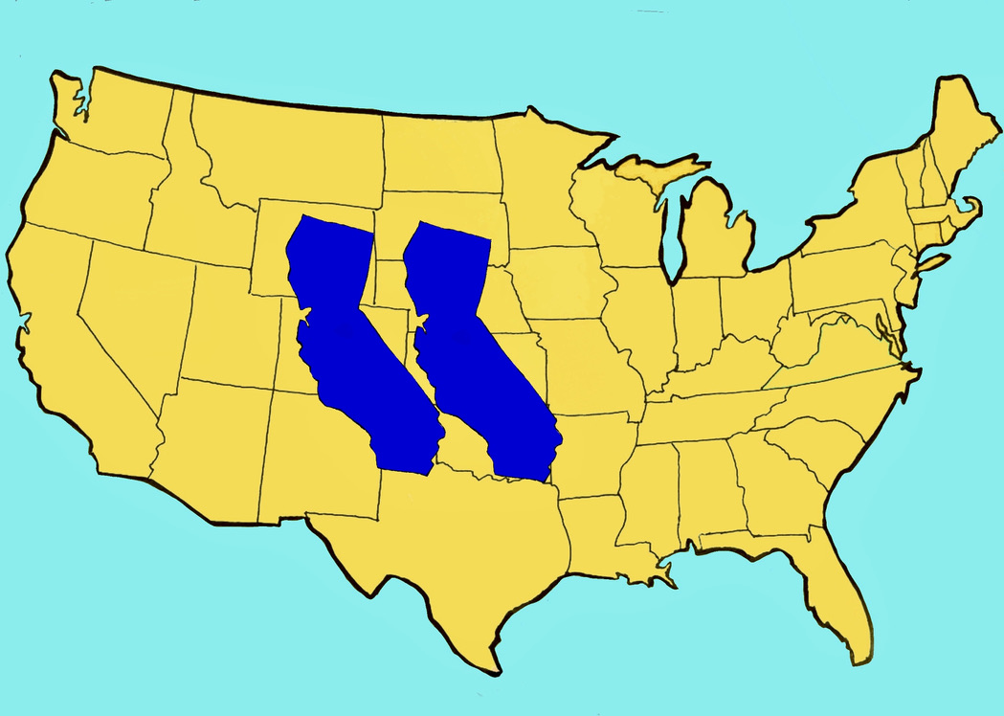
And Cartoonish Amounts of Land
Meeting existing US electricity demand with wind energy would require 900,000 km²
That’s two Californias!
● Vaclav Smil, Energy Myths and Realities, 2010
● Lee Miller & David Keith, Environmental Research Letters, 2018
Image credit: Mary Bryce. Data: A Question of Power: Electricity and the Wealth of Nations
©Robert Bryce
Notes:
A recent Princeton study put figure at 600,000 sq kms. See: https://netzeroamerica.princeton.edu/img/Princeton_NZA_Interim_Report_15_Dec_2020_FINAL.pdf, 106

Slide 26
Federal Tax Incentives Per Unit of Energy Produced, 2021: Solar Got 267x More Than Nuclear, Wind Got 99x More
$ Per EJ
Source: BP, US Treasury, https://home.treasury.gov/policy-issues/tax-policy/tax-expenditures
© Robert Bryce
Notes:
Charlie Munger: Show me the incentive and I’ll show you the outcome.
In 2020, he put it a bit different: If you have dumb incentives, you get dumb outcomes.
Solar is getting 267x more than nuclear
Wind is getting 99x more.
Solar is getting 173x more than oil and gas
Wind is getting 64x more than oil and gas

Slide 27
Nominal Cost Of Existing Energy-Related Tax Incentives, 2022-2031
$3,440
$28,740
$112,930
$US Million
Source: US Treasury, https://home.treasury.gov/policy-issues/tax-policy/tax-expenditures;
© Robert Bryce

Slide 28
Existing Energy-Related Tax Incentives + New Manchin-Schumer Tax Credits, 2022-2031
$33,440
$28,740
$239,800
$US Million
Source: US Treasury, https://home.treasury.gov/policy-issues/tax-policy/tax-expenditures; https://www.cbo.gov/system/files/2022-08/hr5376_IR_Act_8-3-22.pdf
© Robert Bryce

Slide 29
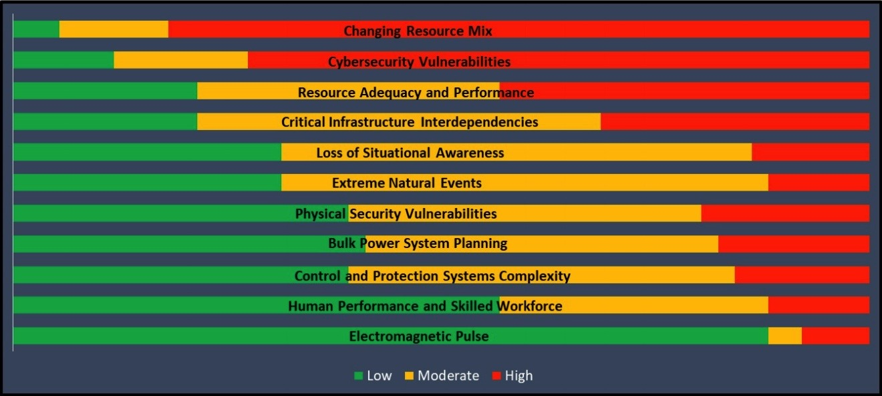
NERC “ERO Reliability Risk Priorities Report,” August 12, 2021:
America’s electric generation capacity “is increasingly characterized as one that is sensitive to extreme, widespread, and long duration temperatures as well as wind and solar droughts.”
Source: https://www.nerc.com/comm/RISC/Documents/RISC%20ERO%20Priorities%20Report_Final_RISC_Approved_July_8_2021_Board_Submitted_Copy.pdf
© Robert Bryce
Notes:
Changing Resource Mix is biggest concern.

Slide 30
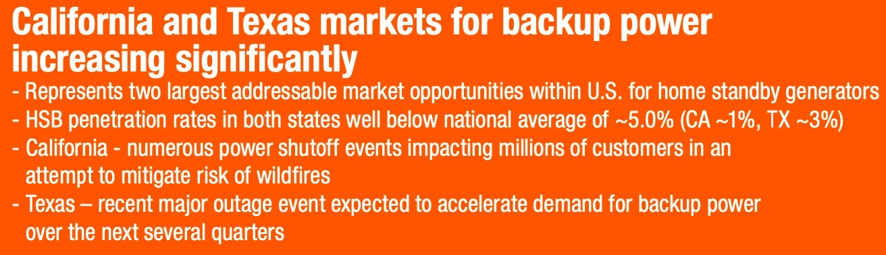
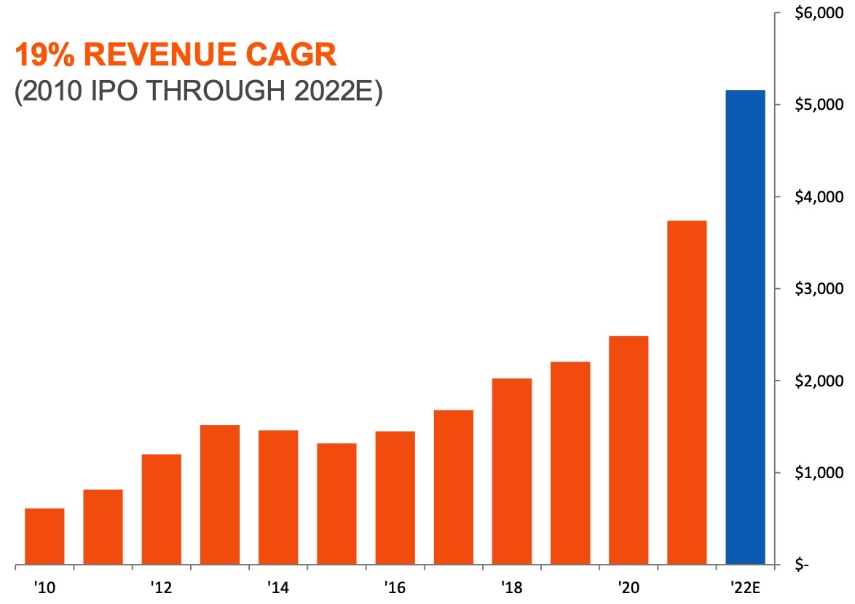
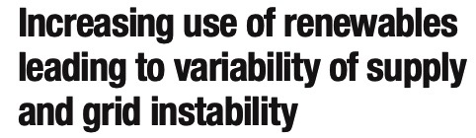

What’s Good For Generac
Is Bad For America
Source: Generac: http://investors.generac.com/static-files/bafdf782-884c-4c37-b276-c7ad7d669922
© Robert Bryce

Slide 31
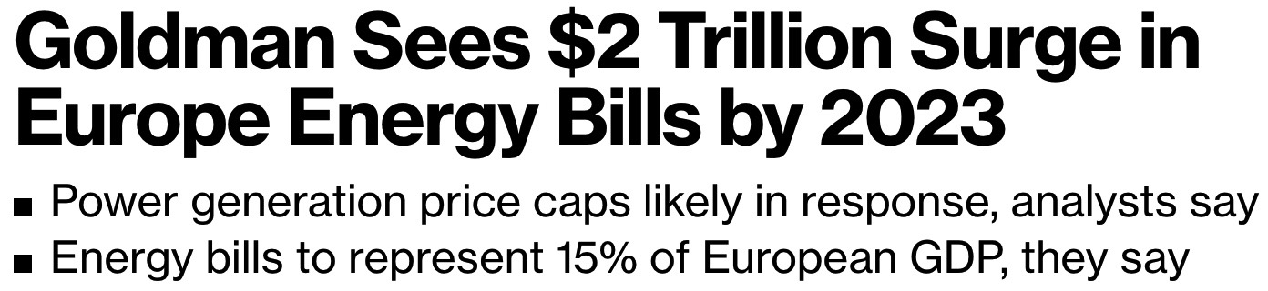

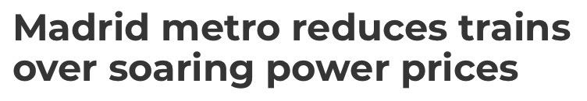

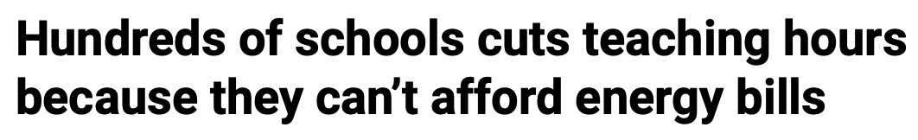
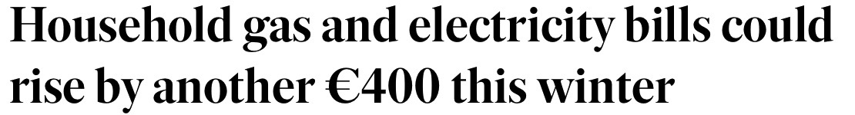
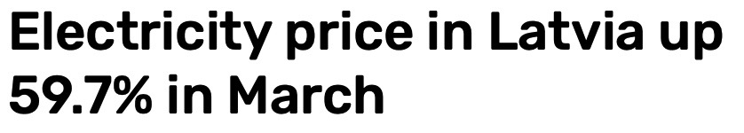

Europe’s Energy Suicide
Source: Media outlets
© Robert Bryce

Slide 32
Europe Committed
The Fatal Quadfecta
● Overinvested in weather-dependent renewables
● Underinvested in hydrocarbons
● Shuttered coal and nuclear power plants
● Relied too heavily on imports
Source: Media outlets
© Robert Bryce

Slide 33

Eurometaux to EU Commission:
“Existential threat to our future,
...permanent deindustrialization”
● “50% of the EU’s aluminum and zinc capacity has already been forced offline”
● “Producers face electricity and gas costs over 10 times higher than last year...”
● “long-term investment climate for all EU strategic metals operations...risks being decimated...more closures will follow next year.”
Source: https://eurometaux.eu/media/qnhn5k30/non-ferrous-metals-ceo-letter-on-energy-crisis-06-09-2022.pdf
© Robert Bryce
Notes:
Madrid: The company’s power bill in February hit 12.2 million euros, compared to 3.4 million euros during the same month last year, the spokesman said.

Slide 34

The Iron Law Of Electricity:
People, businesses, and countries will do whatever they have to do to get the electricity they need.
People waiting to buy gasoline for their generators,
Staten Island, NY, November, 2012
© Robert Bryce

Slide 35
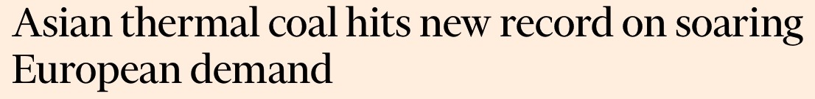
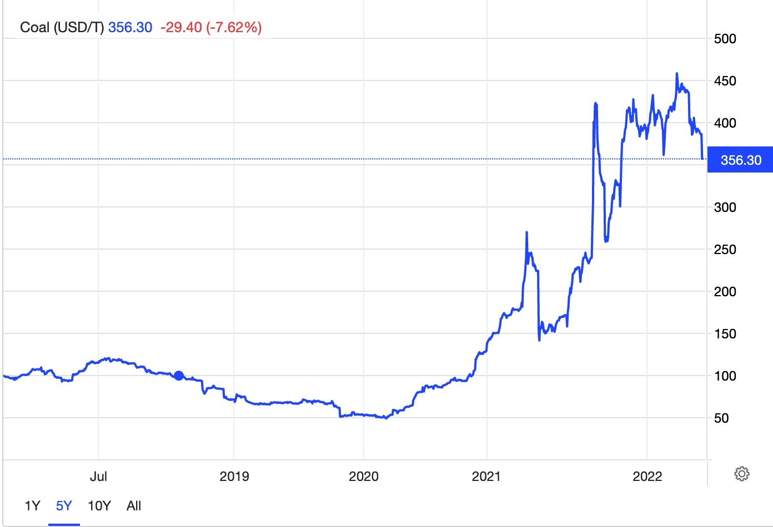
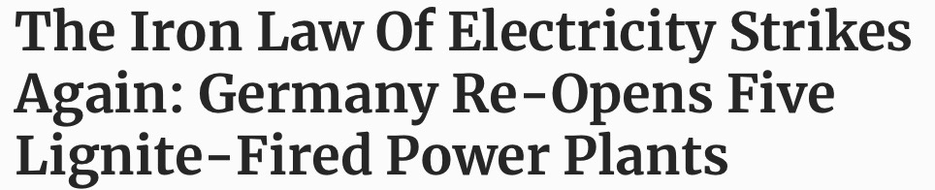
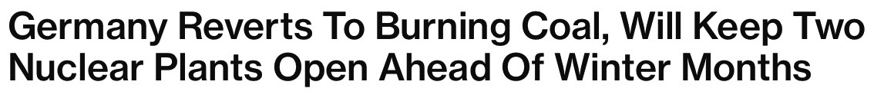

King Coal Comes Storming Back
“China began construction on 15 gigawatts of new coal-fired power...24 GW of new projects were announced or re-activated...The volume of new projects...amounts to almost one coal plant unit per week.”
Source: Media outlets, https://tradingeconomics.com/commodity/coal https://time.com/6090732/china-coal-power-plants-emissions/
© Robert Bryce

Slide 36
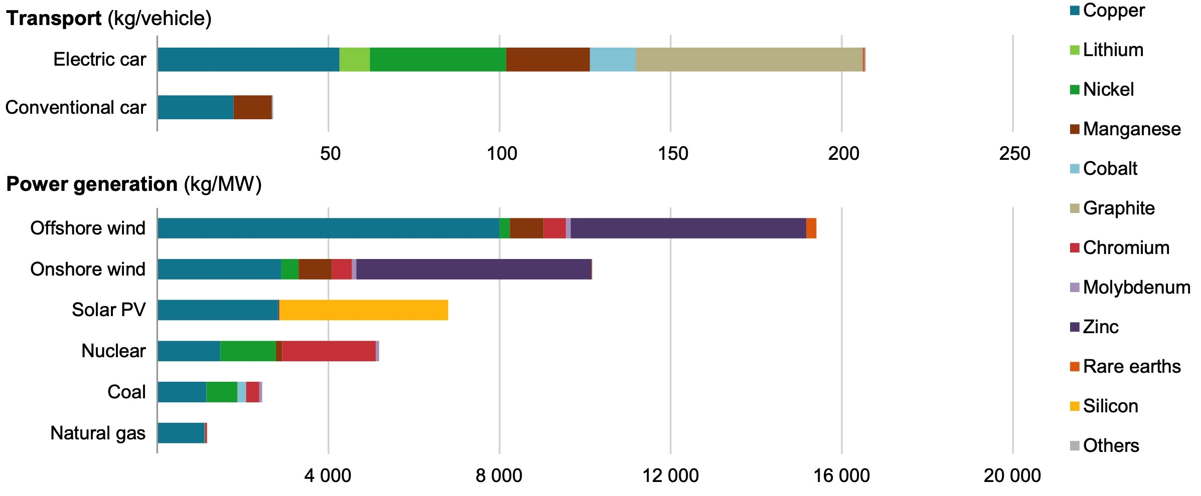
IEA: “The Role of Critical Minerals In Clean Energy Transitions”
Source: IEA, https://iea.blob.core.windows.net/assets/ffd2a83b-8c30-4e9d-980a-52b6d9a86fdc/TheRoleofCriticalMineralsinCleanEnergyTransitions.pdf
© Robert Bryce
Notes:
Electrifying half of the U.S. motor vehicle fleet would require in rough terms:
9 times the world’s annual cobalt production,
4 times global neodymium output
3 times global lithium production
2 times world copper production.
Except for copper, China has a majority share in the processing of all of those minerals, including a 90% share in rare earths, including neodymium.

Slide 37
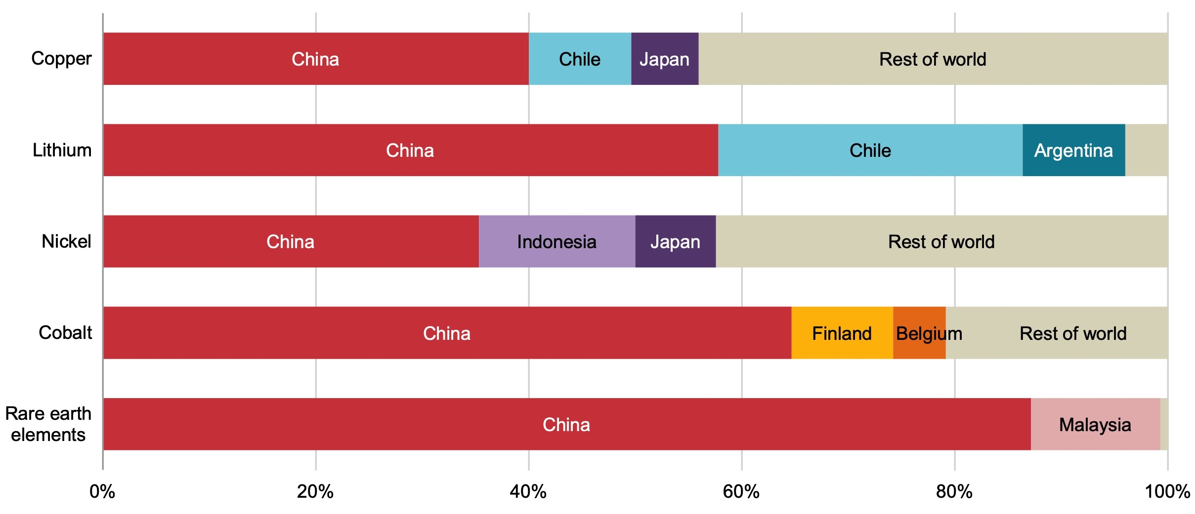
Who Dominates Critical Metals Processing?
Source: IEA, https://iea.blob.core.windows.net/assets/ffd2a83b-8c30-4e9d-980a-52b6d9a86fdc/TheRoleofCriticalMineralsinCleanEnergyTransitions.pdf
© Robert Bryce

Slide 38
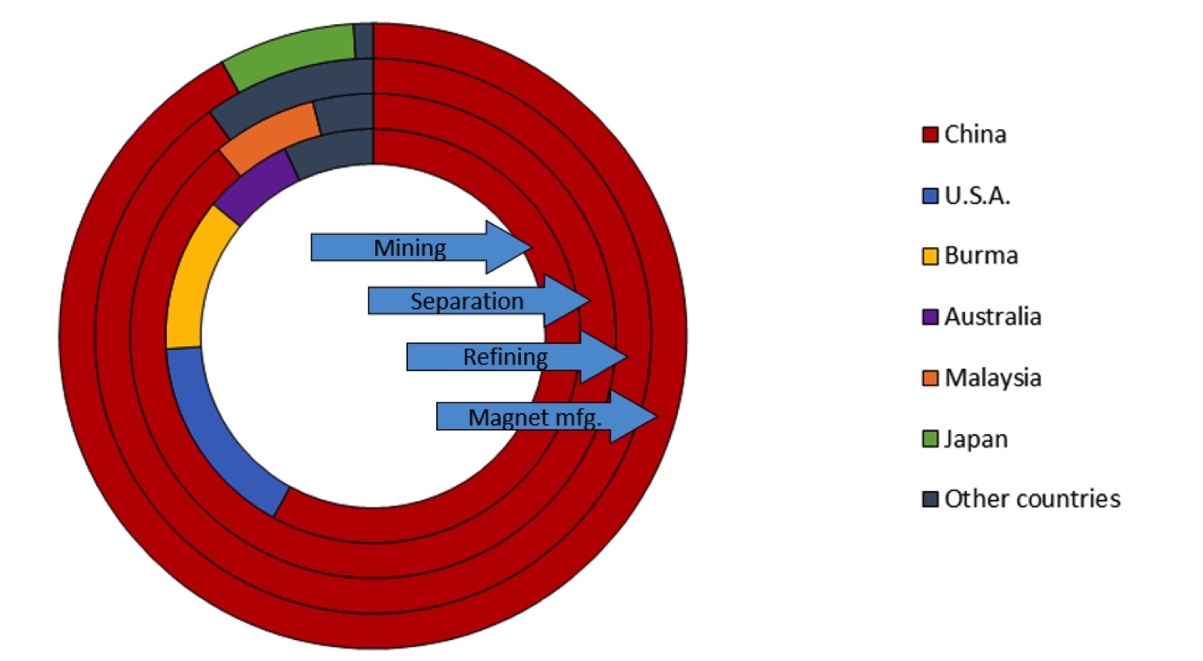
Who Dominates NdFeB Magnets?
Source: https://www.energy.gov/sites/default/files/2022-02/Neodymium%20Magnets%20Supply%20Chain%20Report%20-%20Final.pdf .
© Robert Bryce
Notes:
New DOE report: China controls 92% of Nd magnet production.

Slide 39
N2N: Natural Gas to Nuclear
  ● 3B+ people need a LOT more juice
  ● ESG push is demanding low- or no-carbon
  ● Power density, material intensity, & EROEI
  ● Technologies are mature
  ● Renewables can’t scale, not dispatchable, land-use

Slide 40
Areal Power Density (W/m²) of Alt-Energy Compared to Natural Gas & Nuclear
Watts per square meter
Sources: Entergy, Bureau of Economic Geology, Jesse Ausubel, author calculations.
© Robert Bryce
Notes:
The Marcellus numbers are from the Bureau of Economic Geology here at UT Austin, and they are calculated in final terms, that is, after the gas has been put through a generator to produce electricity.

Slide 41
Iron Law of Power Density:
The Lower The Power Density, The Greater The Resource Intensity
Tons of material per TWh
Source: Department of Energy, 2017. https://www.energy.gov/sites/prod/files/2017/03/f34/quadrennial-technology-review-2015_1.pdf, 390. See table 10-4.
© Robert Bryce

Slide 42
EROEI of Major Forms of Energy Production
Energy return on energy invested
Source: Goehring & Rozencwajg, Natural Resource Market Commentary, February 2022.
© Robert Bryce

Slide 43
Why Nuclear?
  ● Needs 10,000x less land than wind, 1,000x less than solar
  ● Low material intensity
  ● Highest EROEI
  ● Price hedge against hydrocarbons
  ● Challenges: NRC, NGOs, cost, political/regulatory risk
  ● Needs: Capital, regulatory reform, “green” label

Slide 44
US vs China: Nuclear Reactors Planned Or Under Construction
● China spending $400B
● Goal: 200 GW by 2035
● New HTGR in Shandong
Source: https://www.bloomberg.com/news/features/2021-11-02/china-climate-goals-hinge-on-440-billion-nuclear-power-plan-to-rival-u-s
https://www.solarpowerworldonline.com/2021/08/polysilicon-production-already-moving-out-of-xinjiang-but-china-still-dominates/
© Robert Bryce

Slide 45
Top Issues For MEAG Power
● Vogtle 3 & 4
● Affordability, reliability, and resilience
● Biden administration ignoring EU’s energy disaster
● EPA’s FIP could shutter:
● 42 GW of coal capacity in US by 2026
● 10.8 GW in ERCOT by 2026
● Black swans and black starts
© Robert Bryce
Notes:
Reliability and affordability go hand in hand
Who will turn the wrenches?

Slide 46
Energy Realism
Is
Energy Humanism
©Robert Bryce
Notes:
We have to be clear about what is at stake here.
You have to push energy realism. Energy fantasies drove Europe into the ditch.
The US must avoid that fate.

Slide 47






Juice: How Electricity Explains the World

Slide 48




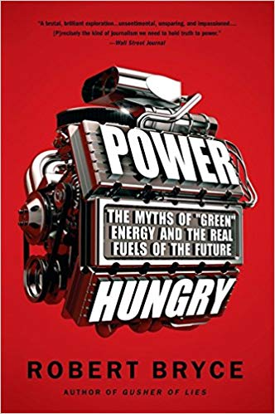

© Robert Bryce

Slide 49








Slide 50
RobertBryce.com
@pwrhungry
Thank you
Notes:
END

